Slide 1


ITC — Information Technology Colleague
رواد مصر الرقمية
Digital Marketing Data
Warehouse System
PROJECT
Powerful • Modern • Premium
ONL4_AIS5_S11
Data
Data engineering
2025 / 2026
شكر وتقدير لإدارة المبادرة ولشركة ITC الشركة المنفذة لتراك

Slide 2
Overview
AGENDA
What we'll cover today
01 Introduction
Our project, Digital Marketing Data Warehouse, aims to solve the challenge of scattered marketing data across multiple platforms such as social media, search engines, and advertising channels. This fragmentation makes it difficult for marketing teams to analyze data and make effective decisions.
To address this, we built an end-to-end data pipeline that extracts marketing data from multiple sources, processes it through ETL (Extract, Transform, Load), and stores it in a centralized data warehouse. During this process, the data is cleaned, transformed, and organized using a Star Schema model to improve analysis and query performance.
The final data is stored on Microsoft Azure, enabling integration with analytics tools like Power BI for dashboard creation and reporting. This allows marketing teams to track performance, analyze key metrics, and make faster, data-driven decisions.
02 Problem Statement
03 Solution Overview
04 System Design
05 Demo
06 Conclusion

Slide 3
Project Overview
Team · Tech Stack · Supervisor
The Team
Project Name
Digital Marketing Data
Warehouse System
سيف ياسر
منة الله أبوالنصر
س
م
Data Engineer
Data Engineer
Tech Stack
Python, SQL, Microsoft Azure, Power BI.
هشام عادل
أحمد سمير
ه
أ
Data Engineer
Data Engineer
Supervisor
ITC
روان حسين
ر
Data Engineer

Slide 4
PROBLEM
Problem
01
Efficiency
Marketing data is distributed across multiple platforms, making data collection and analysis inefficient and difficult to manage.
Statement
The main problem addressed in this project is the fragmentation of digital marketing data across multiple platforms such as social media, search engines, and advertising channels. Since this data is scattered and stored in different formats, it becomes difficult for marketing teams to collect, analyze, and generate accurate insights efficiently. This lack of centralized data slows decision-making and reduces the effectiveness of marketing strategies. Therefore, this project aims to build a centralized data pipeline and warehouse to integrate, process, and analyze marketing data for better business decision-making.
02
Quality
Data from different sources often comes in inconsistent formats, leading to inaccuracies and unreliable reporting.
03
Time
Manual data processing and report generation consume significant time, delaying insights and decision-making.

Slide 5
Proposed Solution
SOLUTION
Main Solution
Benefits
We propose building a centralized Digital Marketing Data Warehouse that collects data from multiple marketing platforms, processes it through an ETL pipeline, and stores it in a unified structure for analysis and reporting.
This solution improves data accessibility, increases reporting accuracy, and enables faster decision-making by providing a single reliable source of marketing data.
Technologies Used
Expected Outcomes
Python, SQL, Microsoft Azure, Power BI, Marketing APIs
The system enables real-time analytics, improves campaign performance tracking, and helps businesses make data-driven decisions more efficiently.

Slide 6
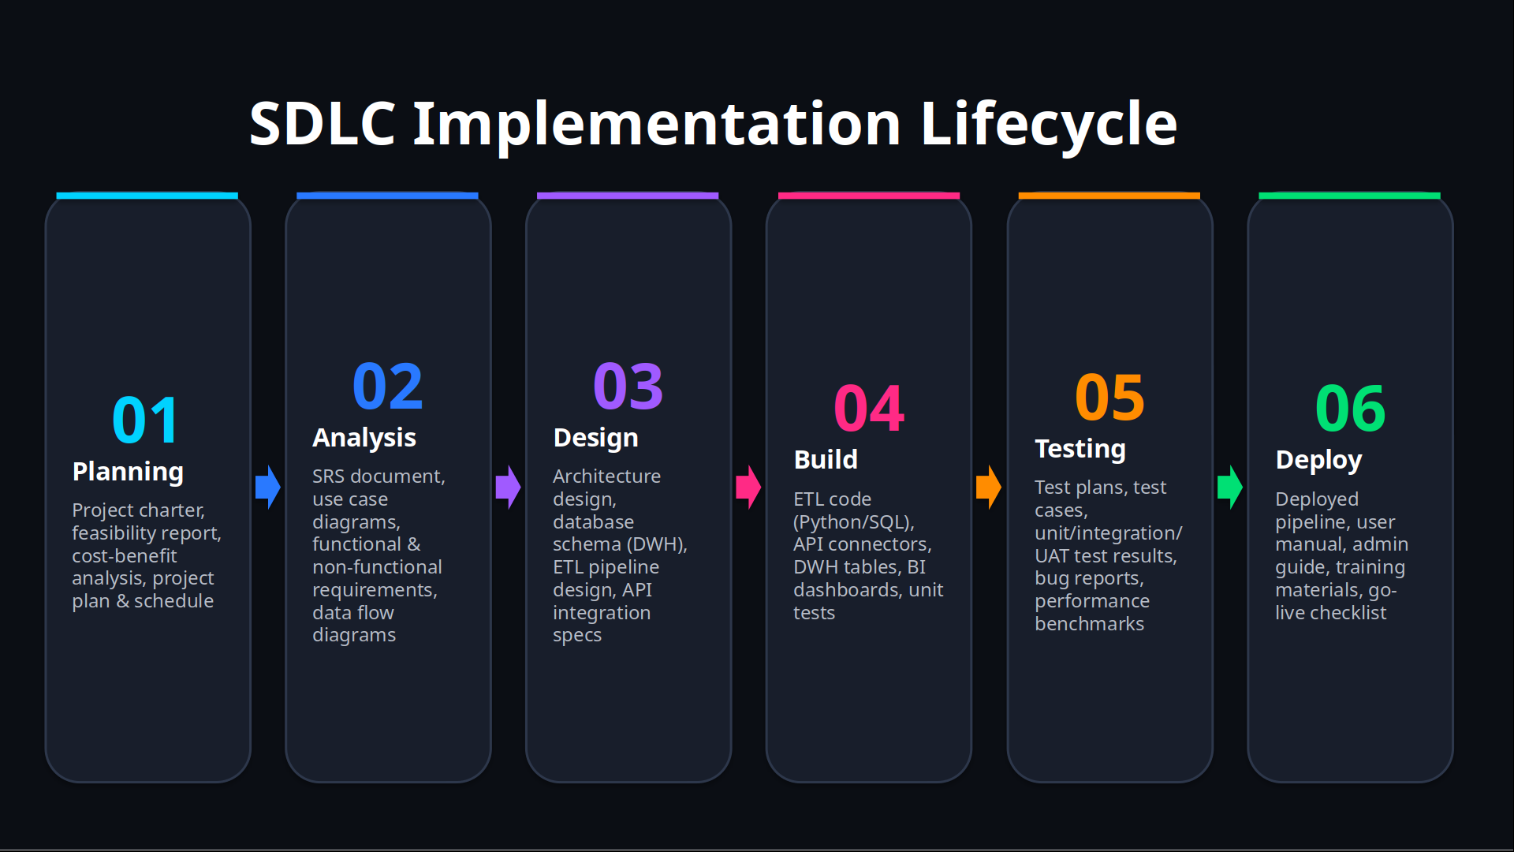

Slide 7
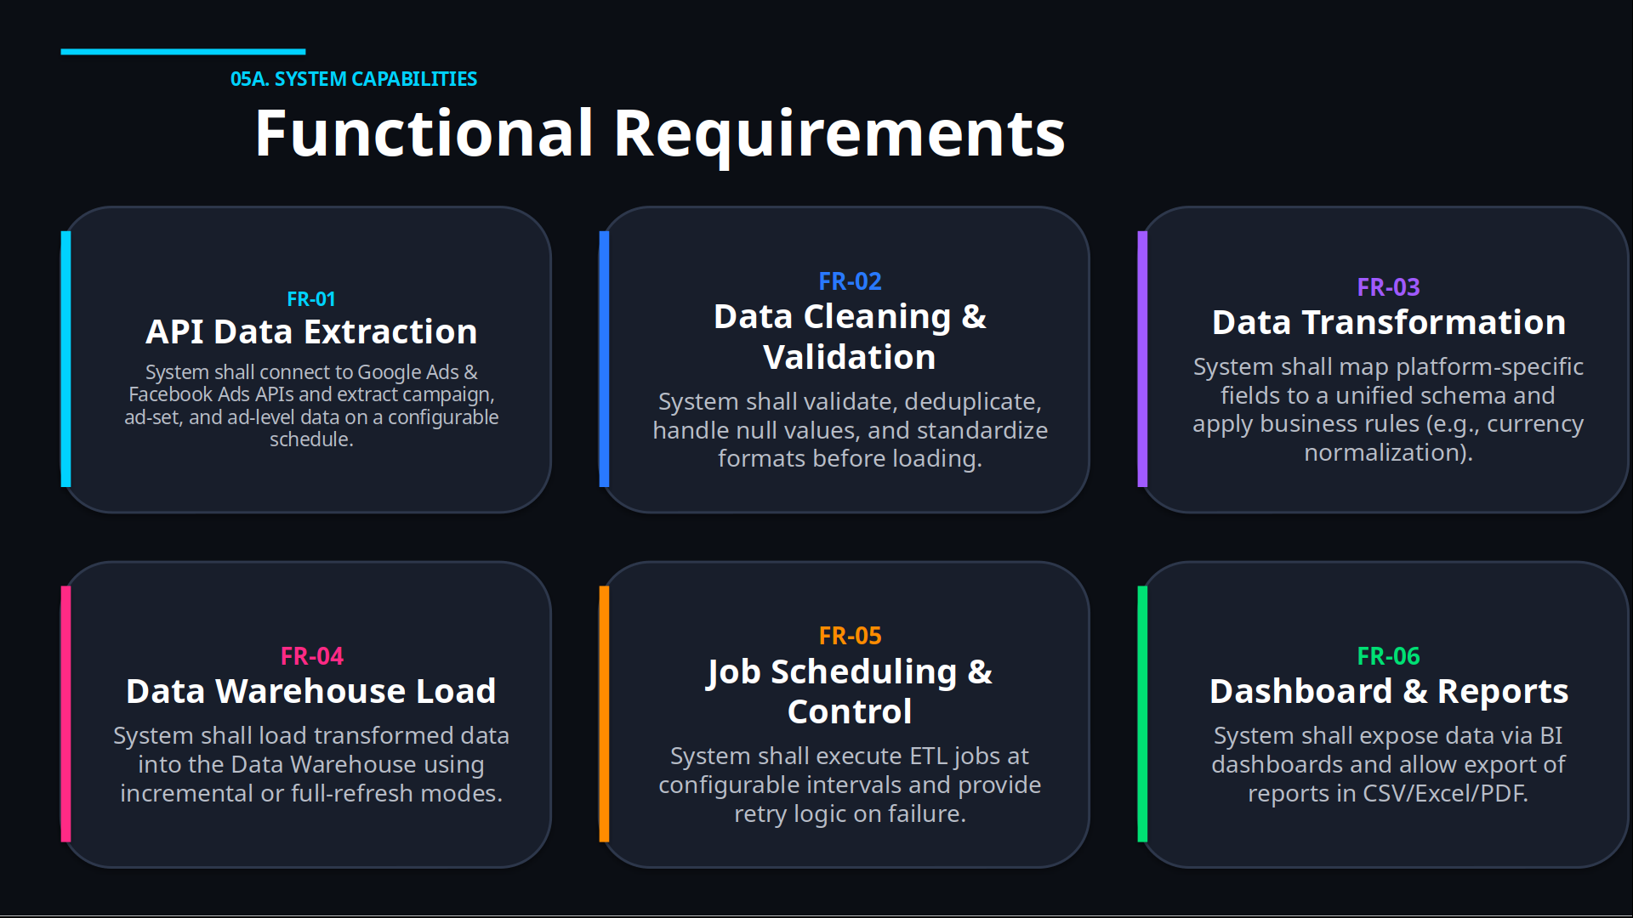

Slide 8
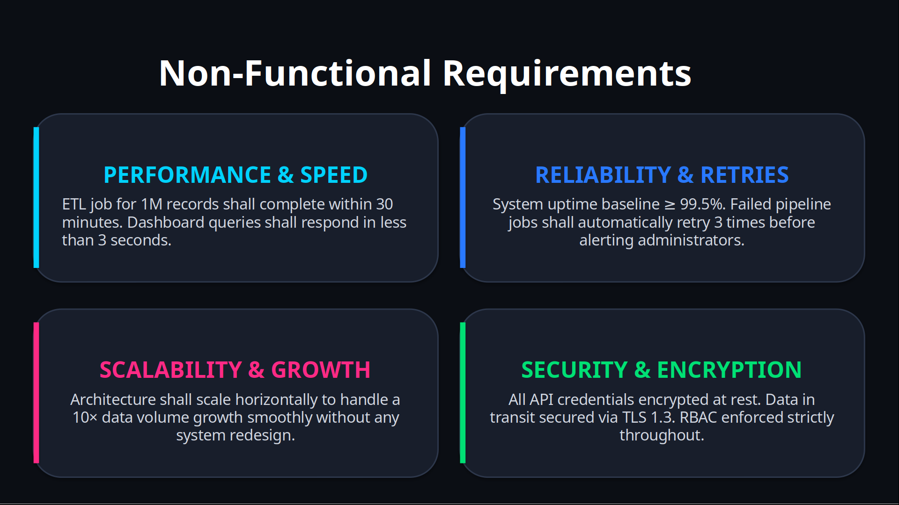

Slide 9
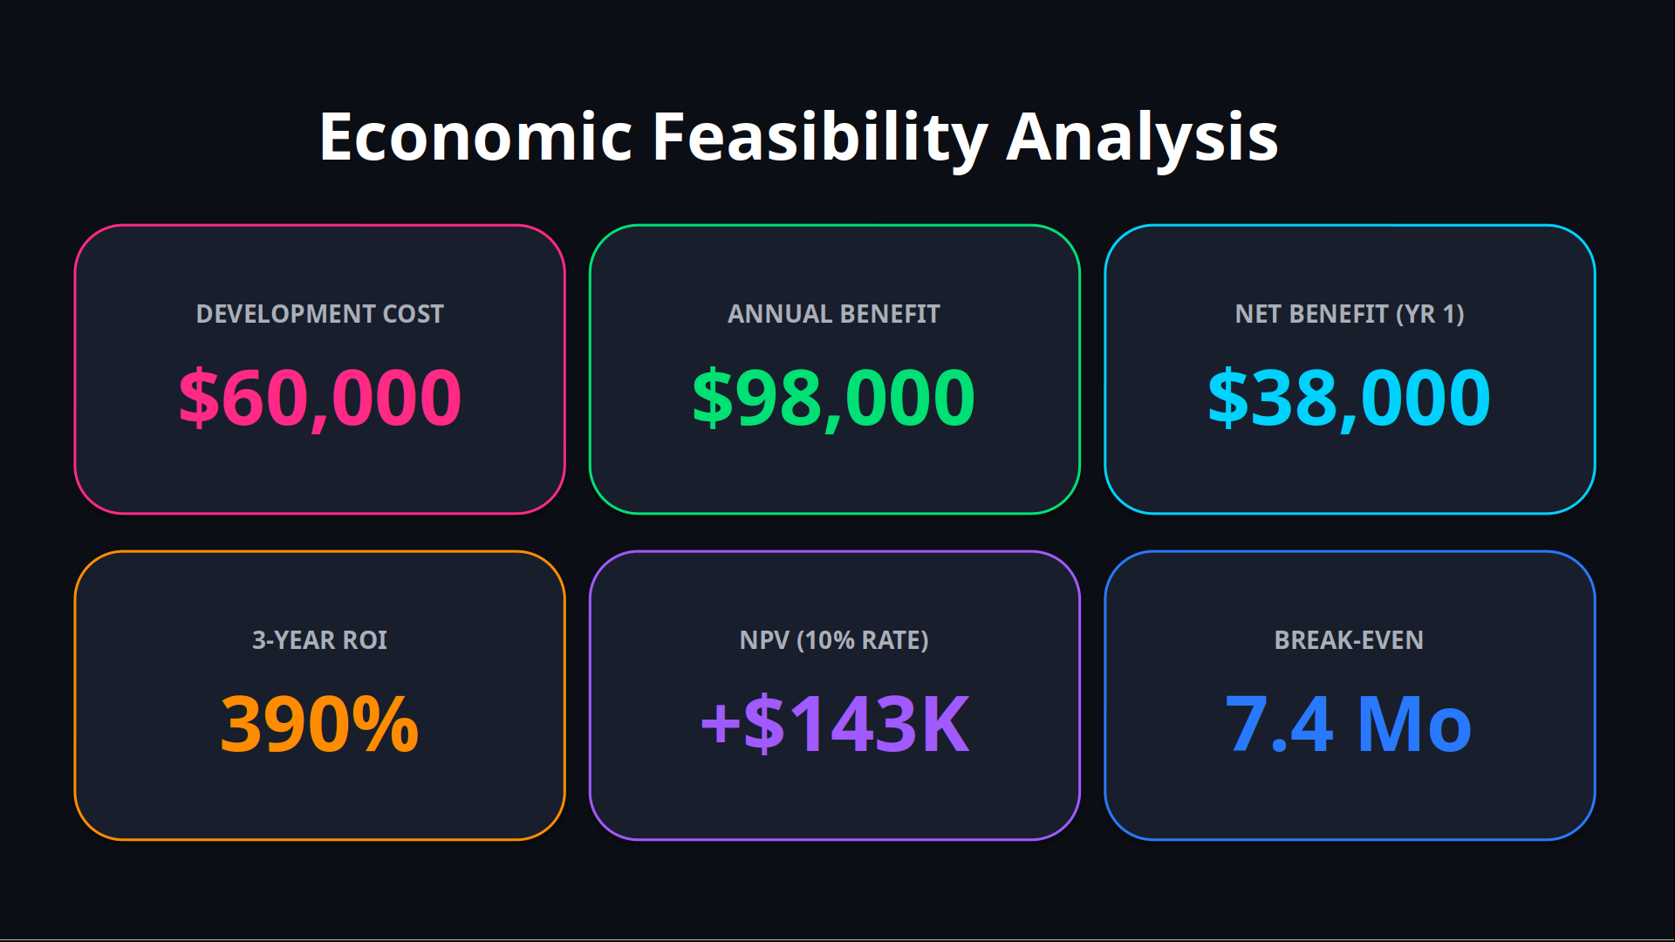

Slide 10
System
1. Architecture
2. Components
Design
3. Data Flow
Data Sources
ETL Pipeline
Data Warehouse
Social Media APIs
Search Engine Data
Campaign Analytics
Data Extraction
Data Cleaning
Data Transformation
Staging Tables
Star Schema
Microsoft Azure Storage

Slide 11
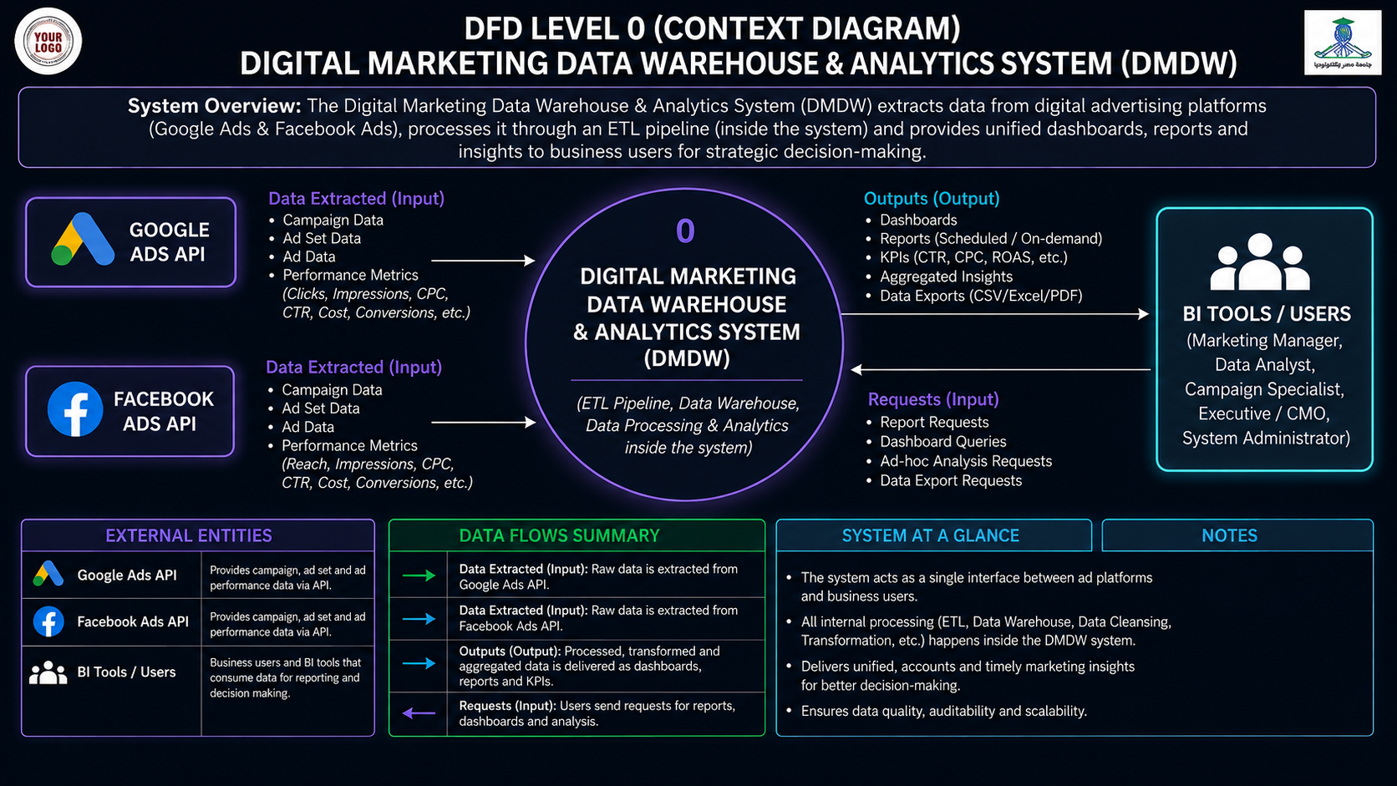


Slide 12
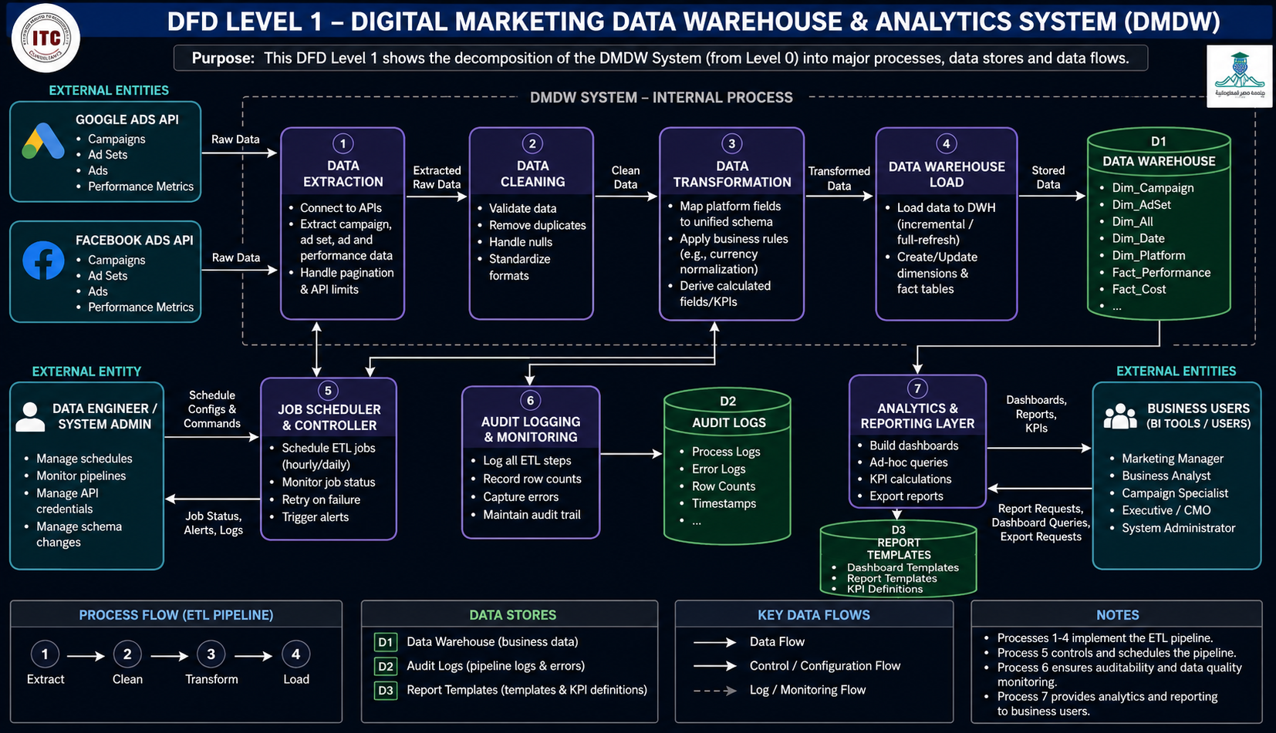

Slide 13
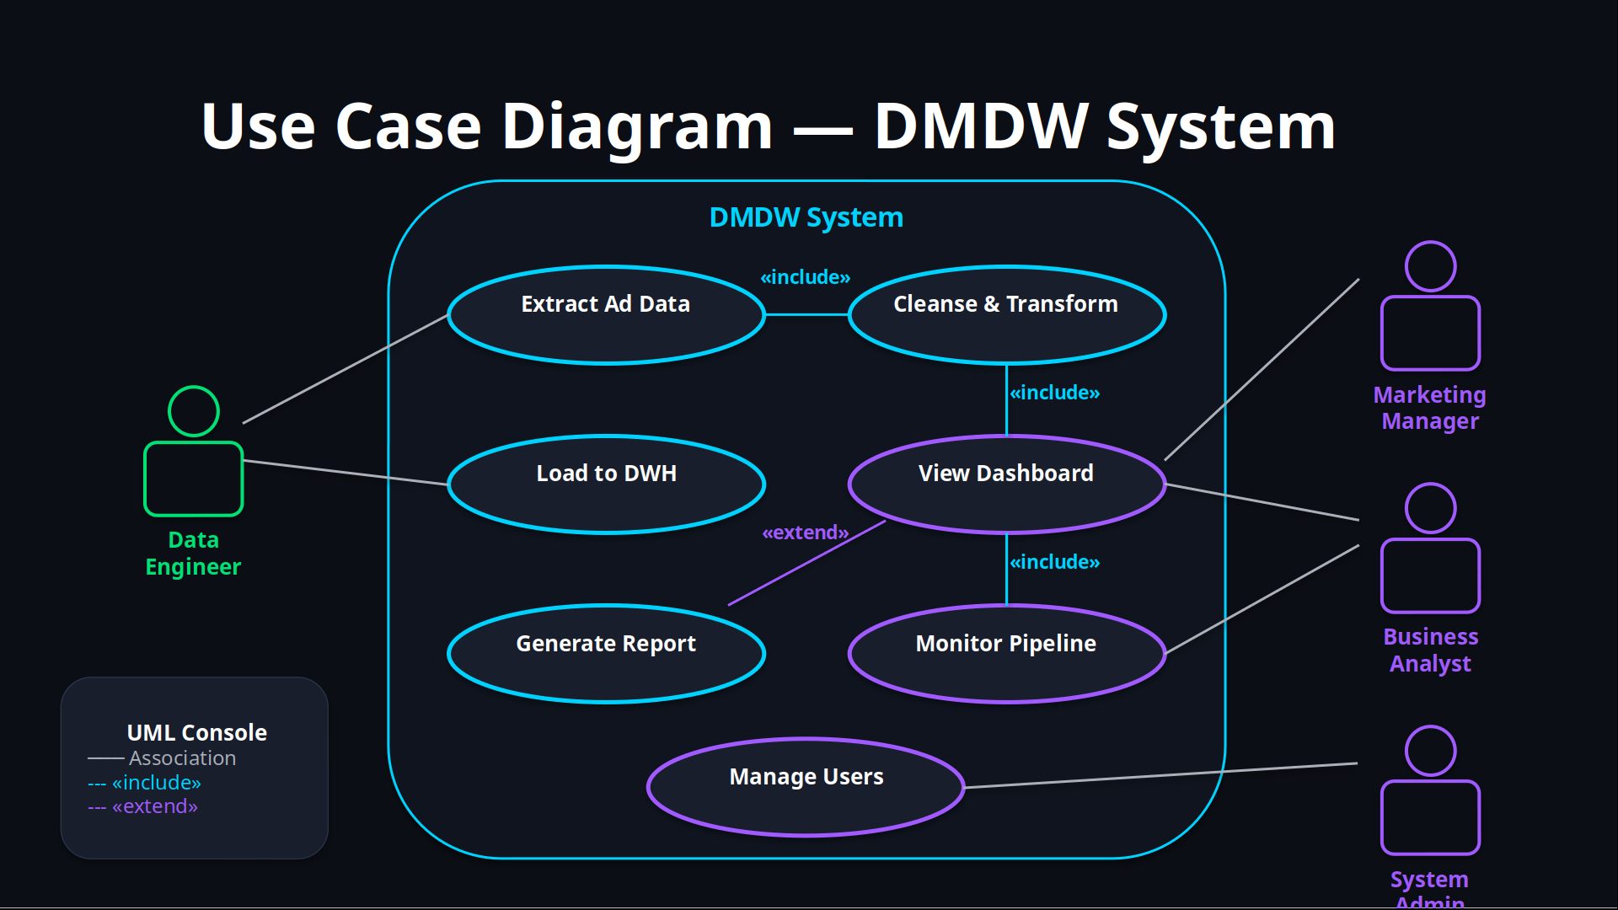

Slide 14


Slide 15
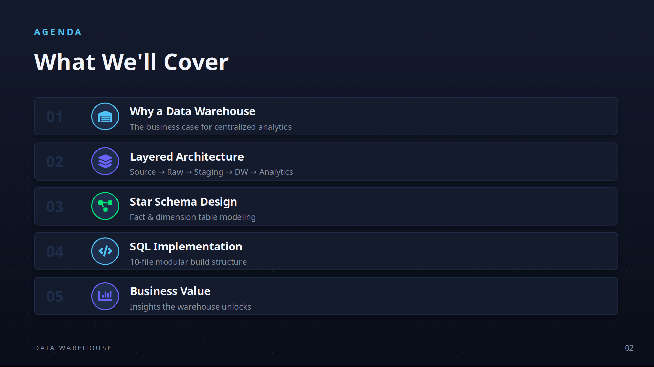

Slide 16
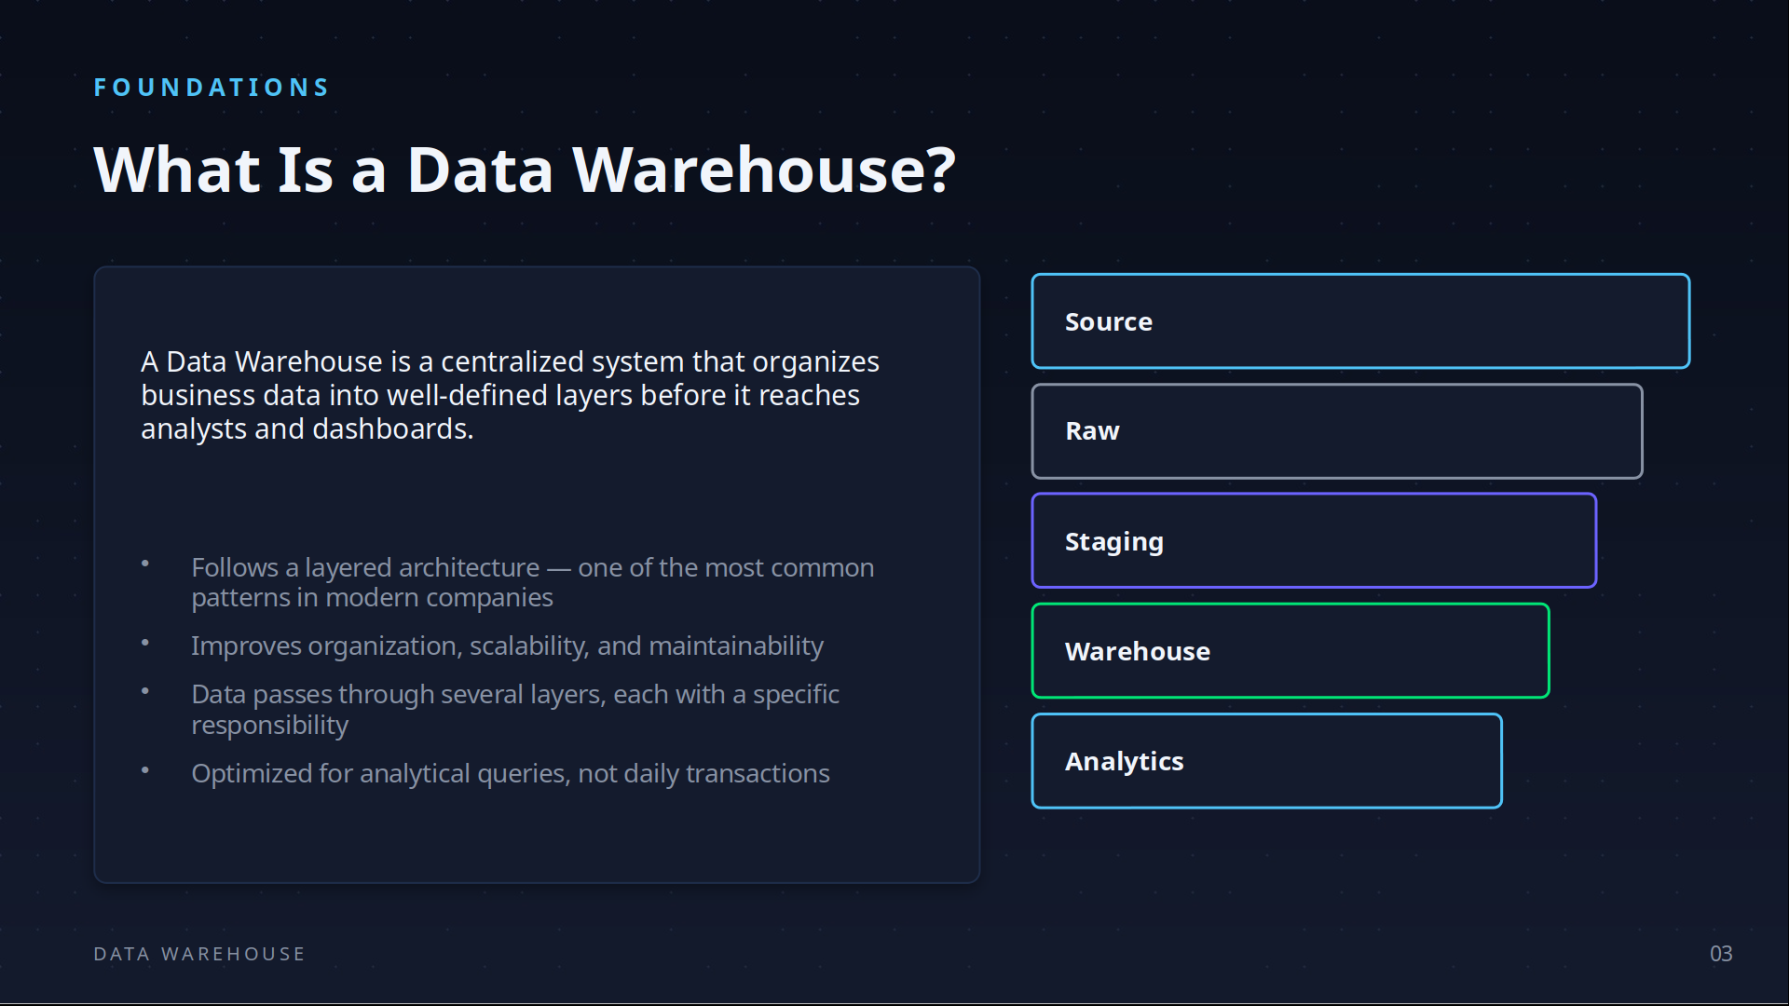

Slide 17
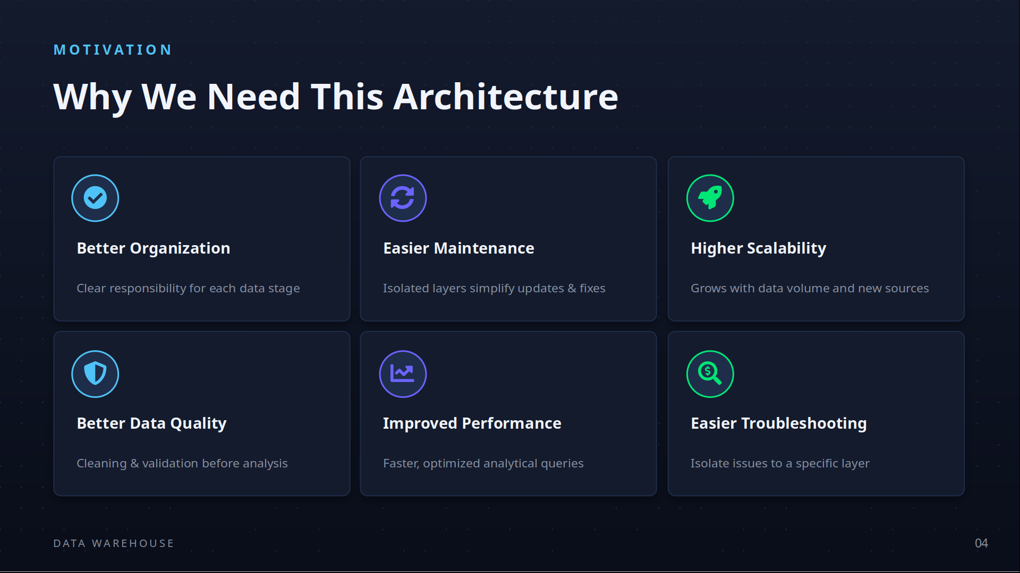

Slide 18
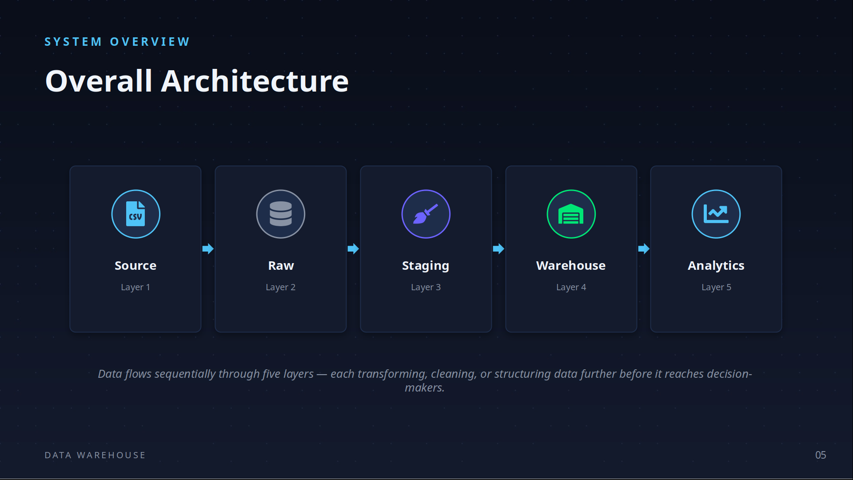

Slide 19
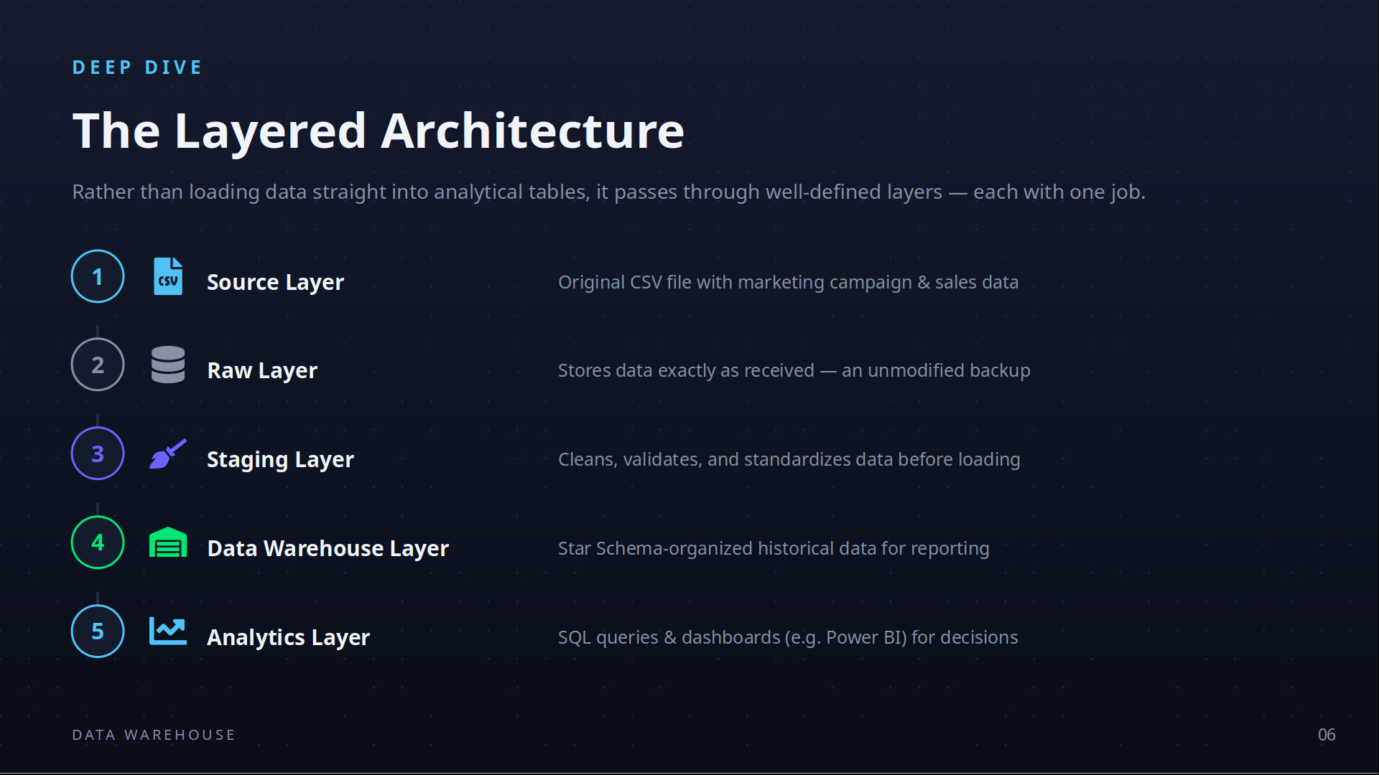

Slide 20
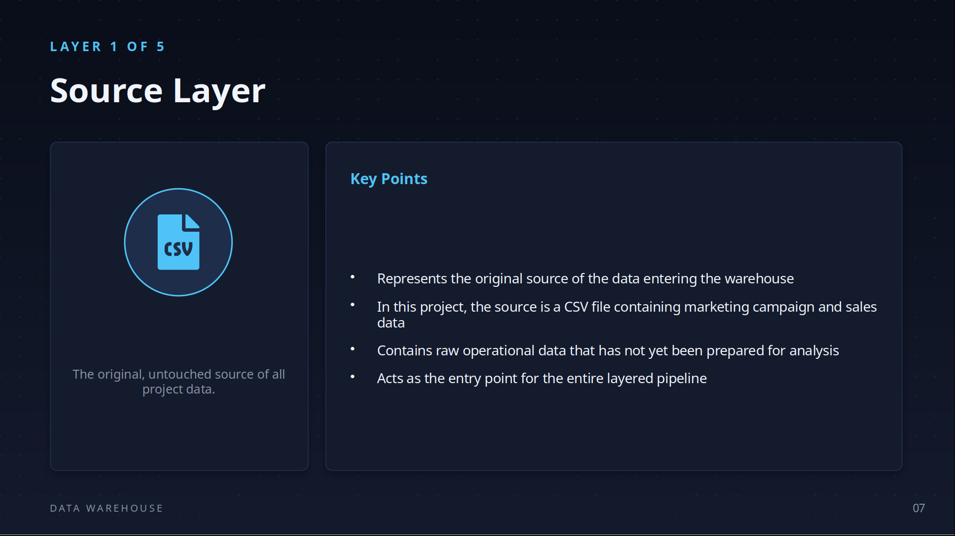

Slide 21
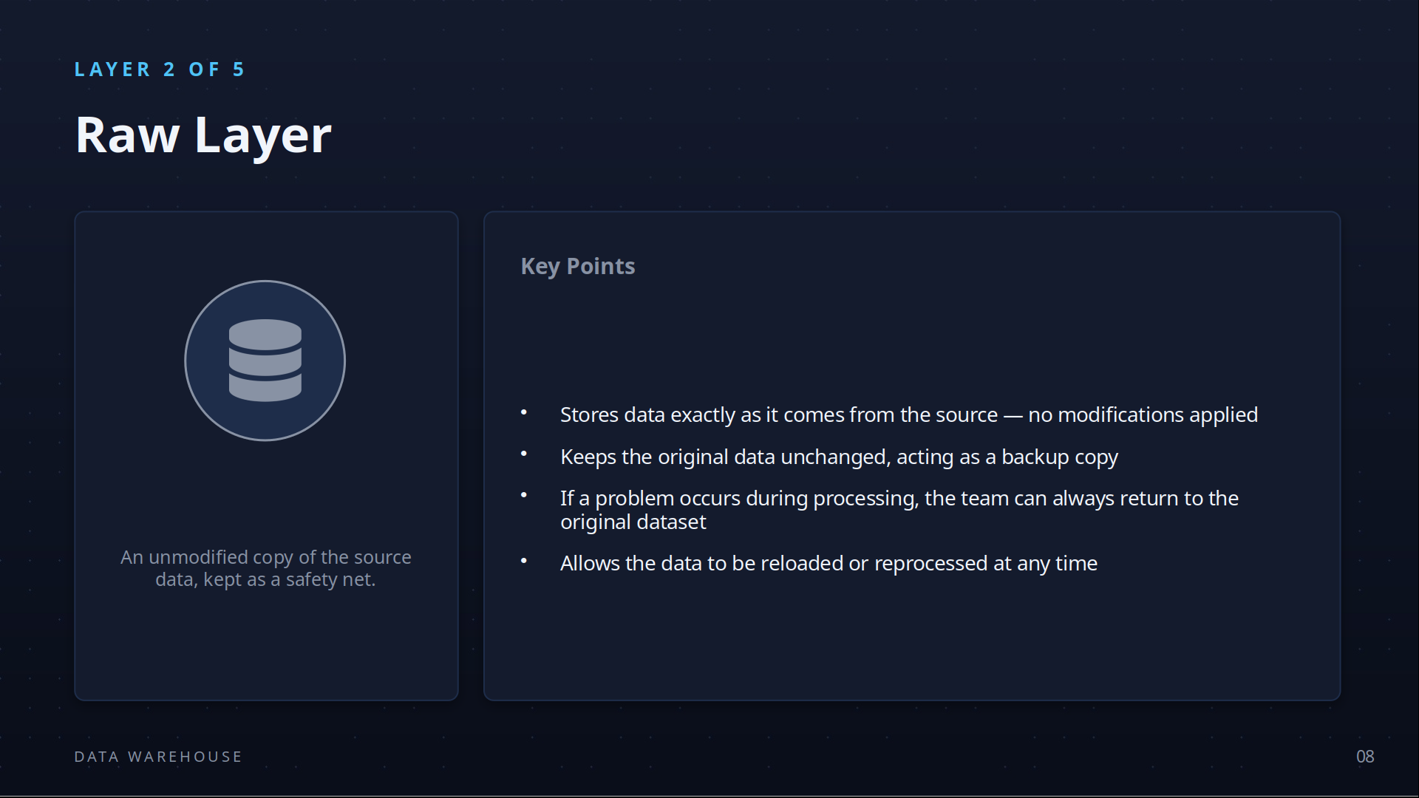

Slide 22
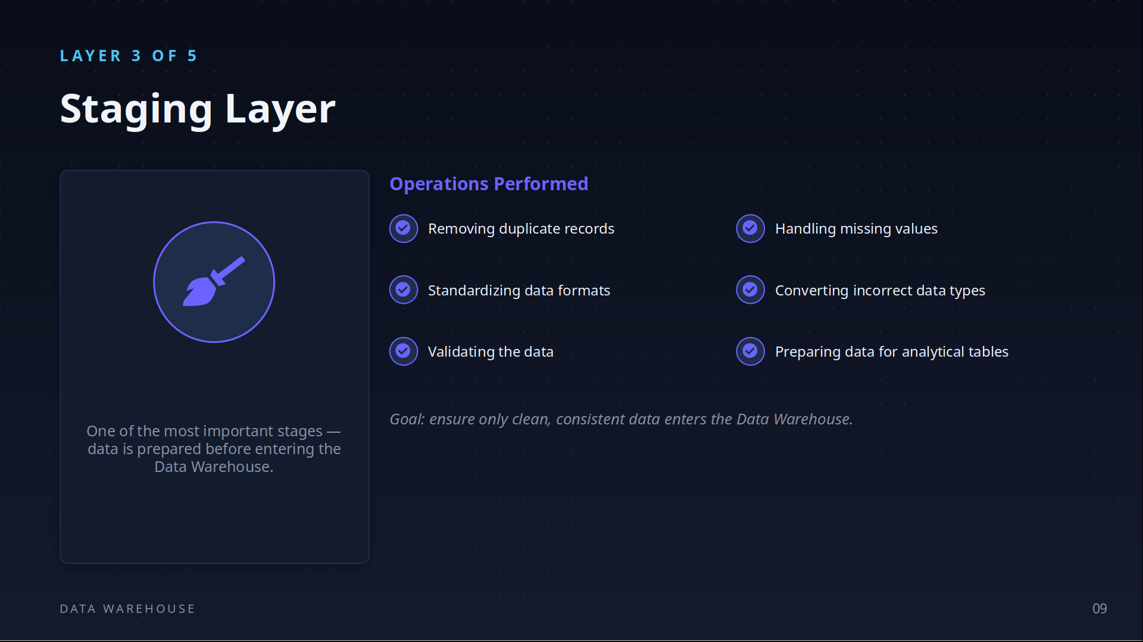

Slide 23
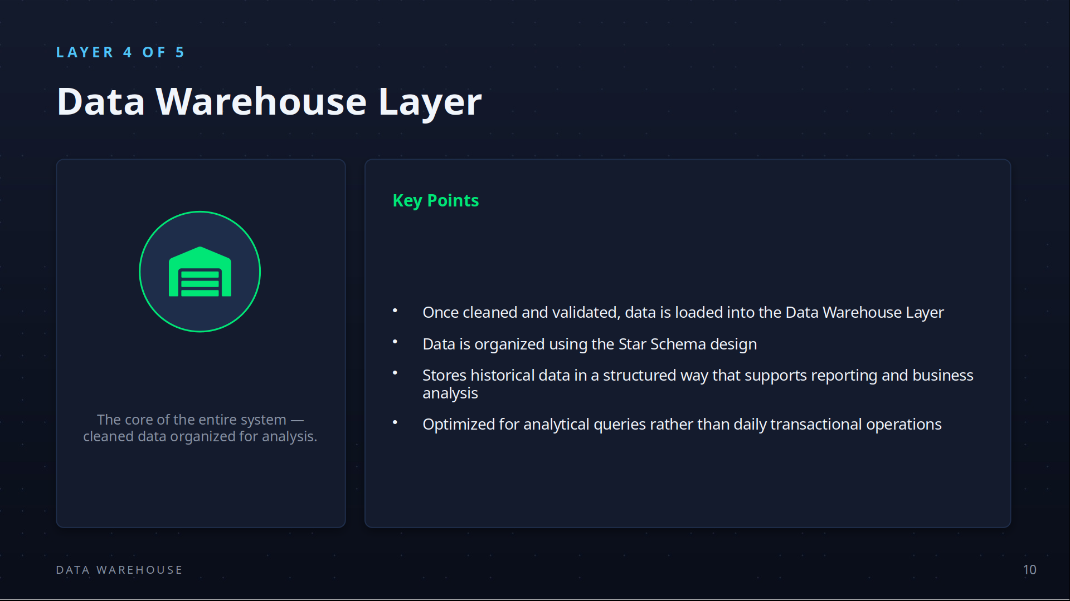

Slide 24
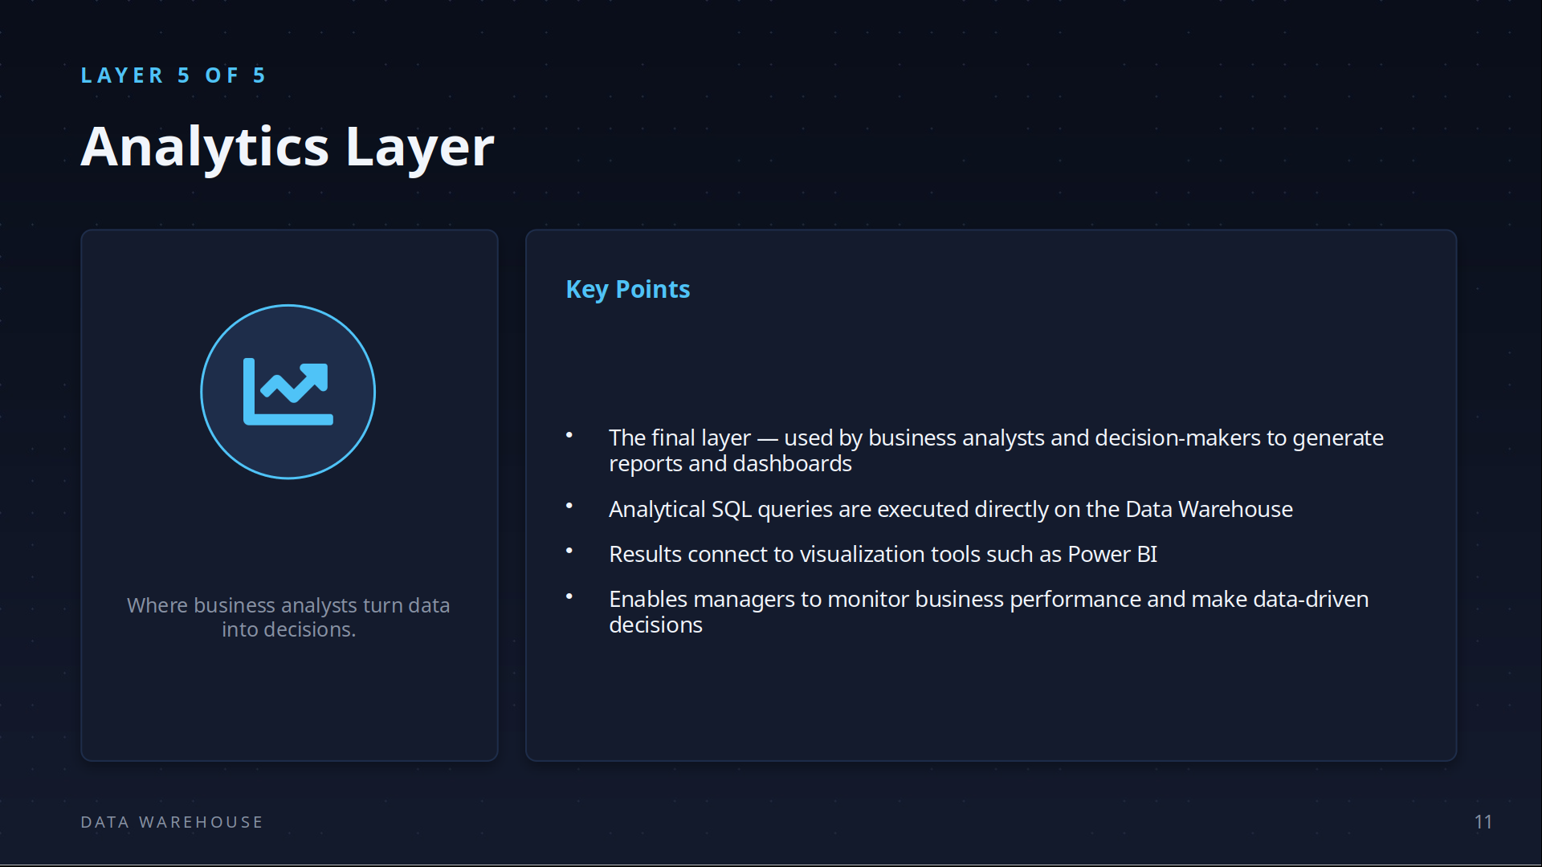

Slide 25


Slide 26
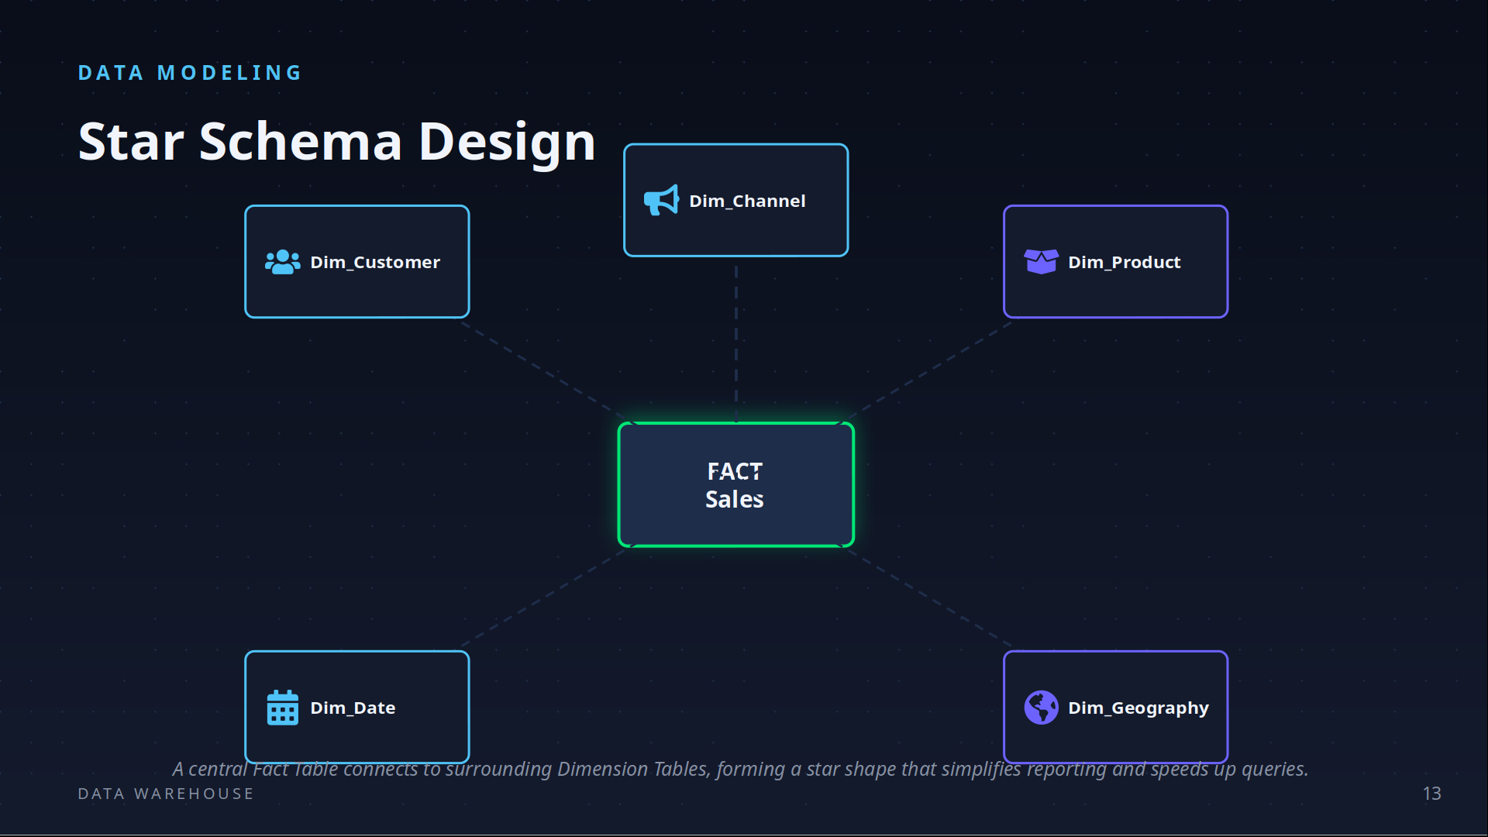

Slide 27
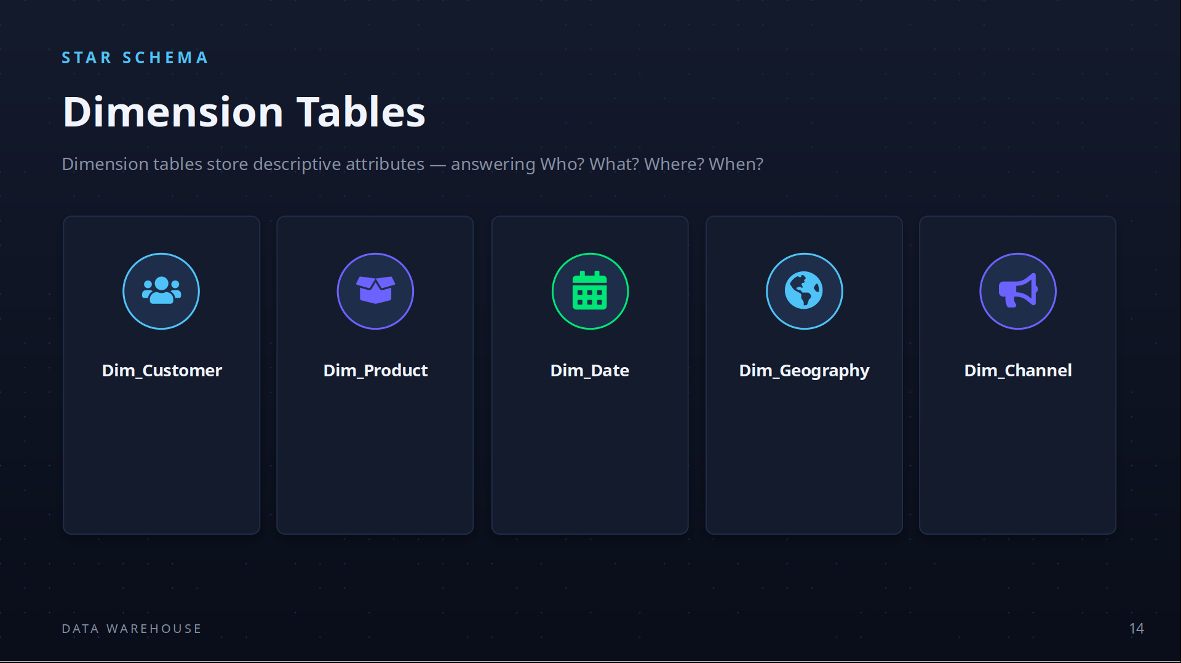

Slide 28
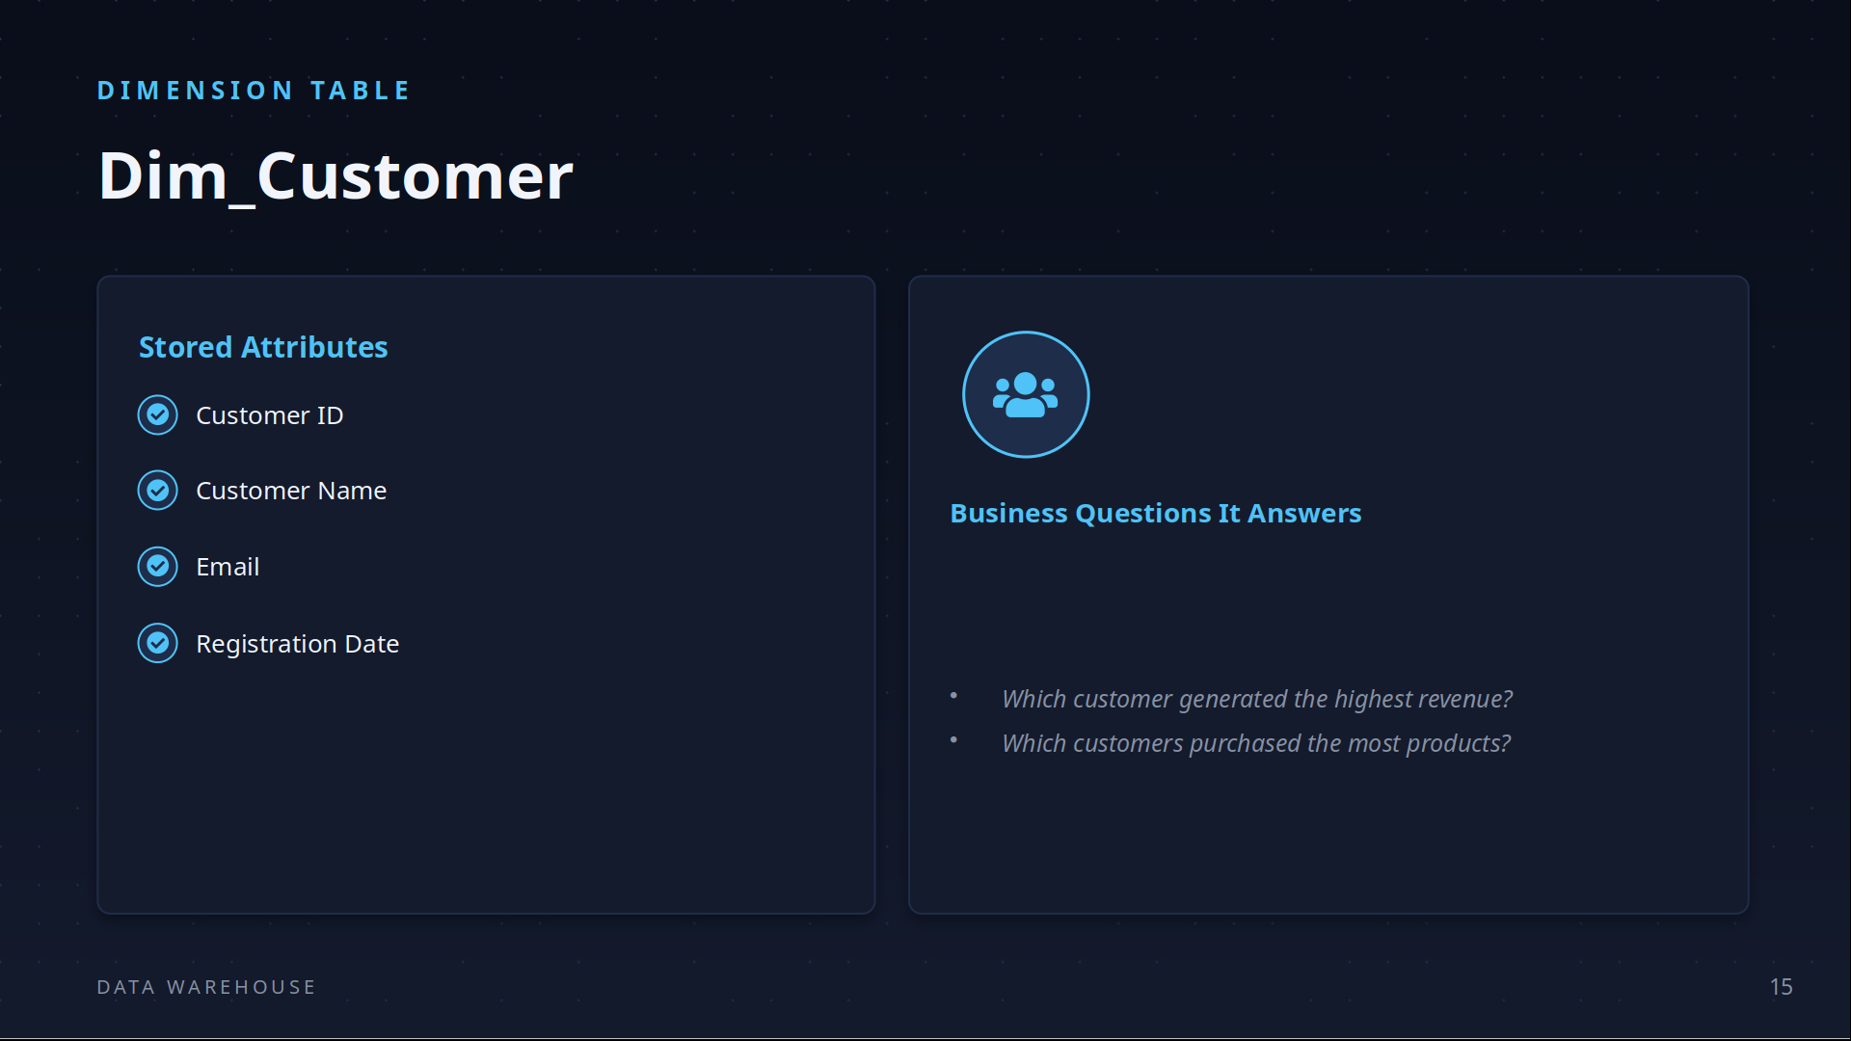

Slide 29
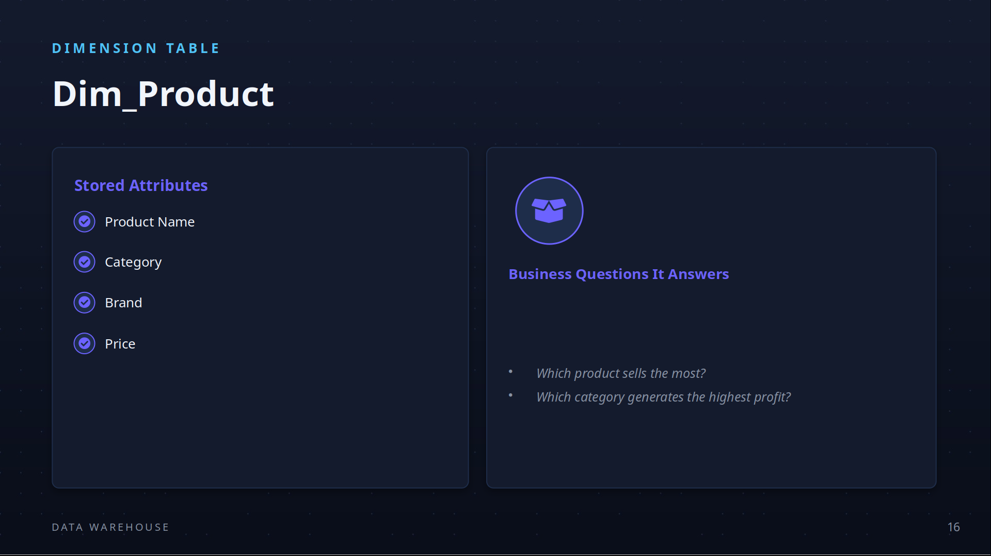

Slide 30
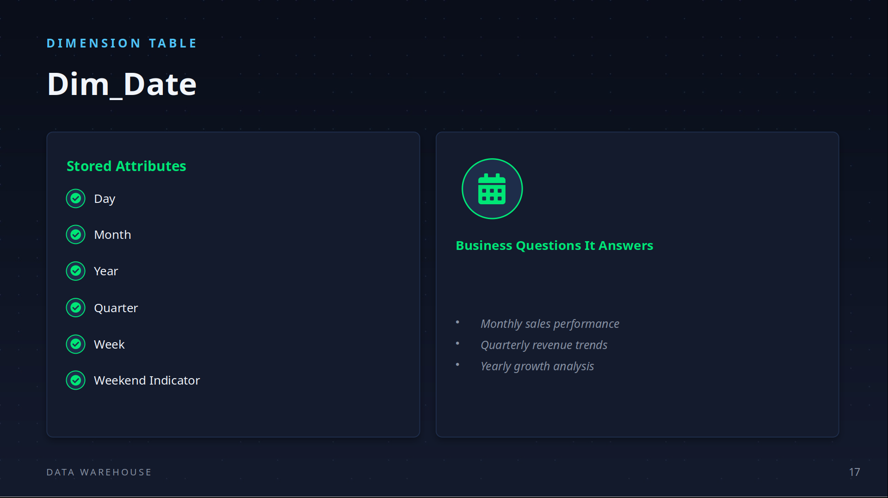

Slide 31
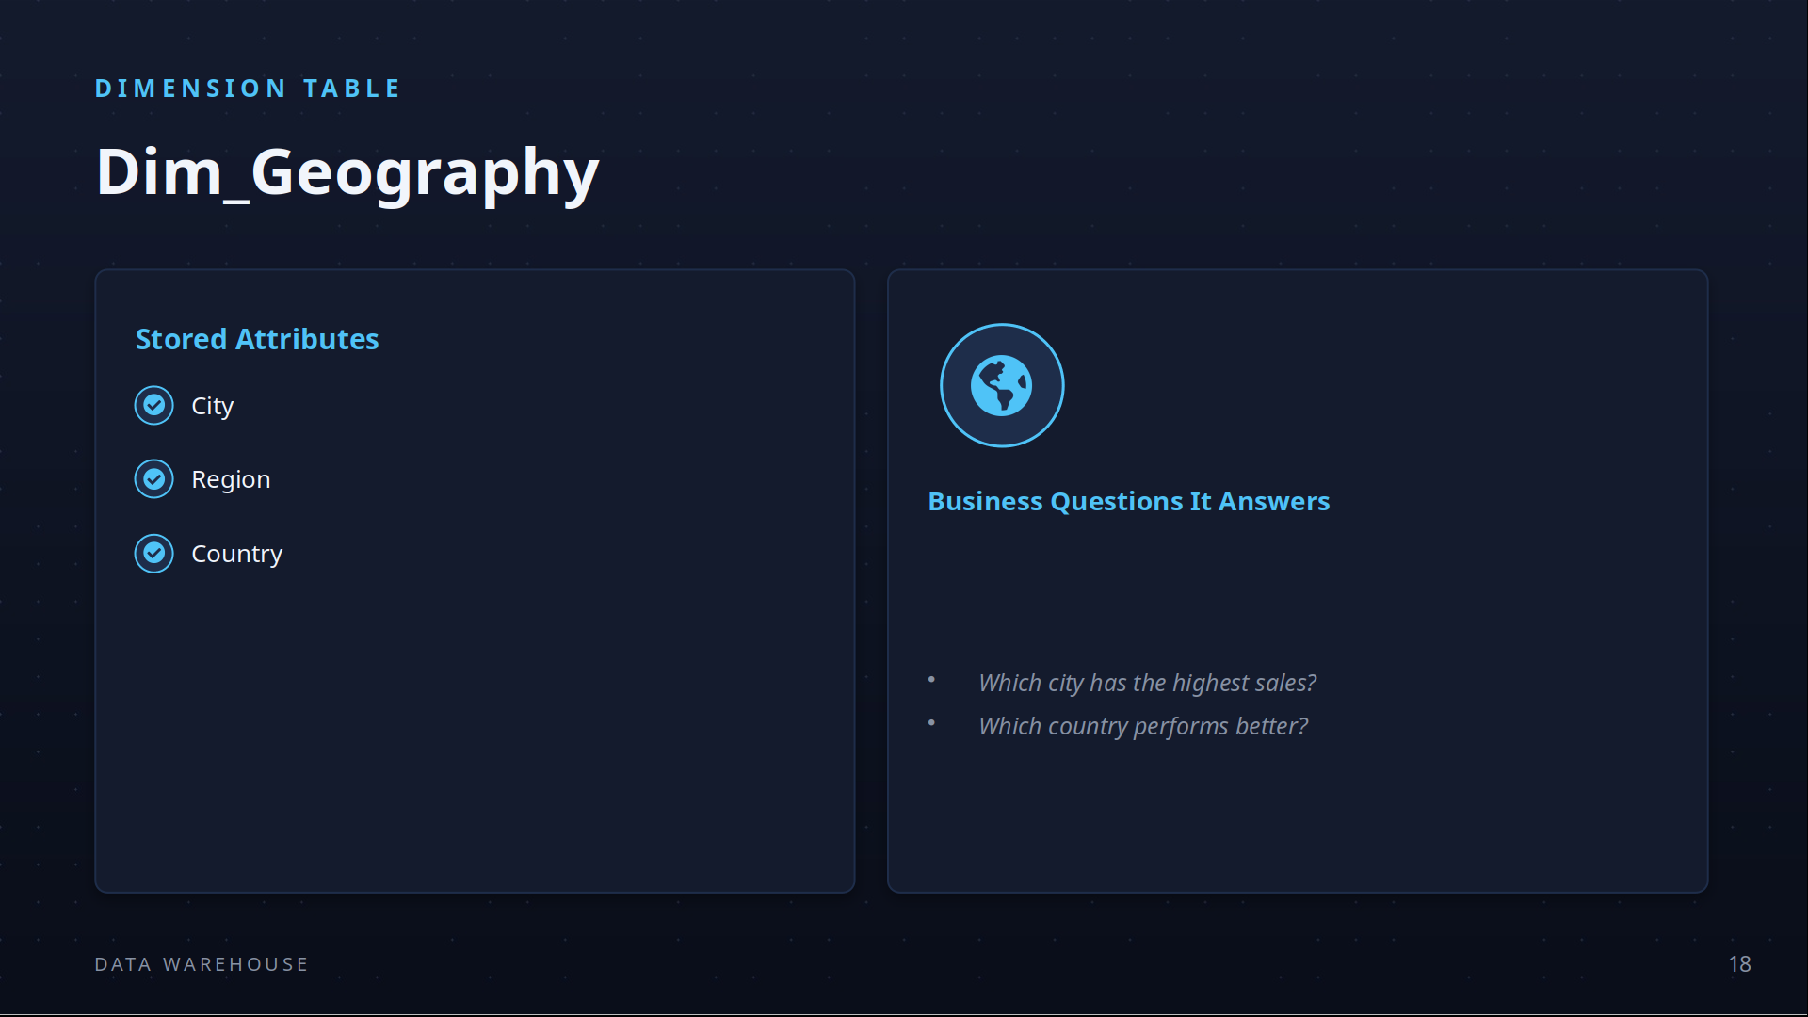

Slide 32
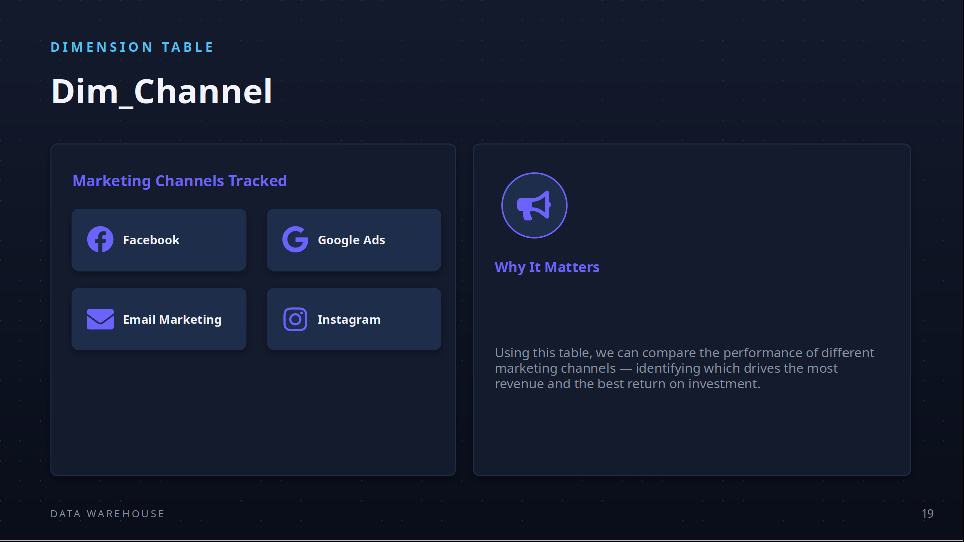

Slide 33
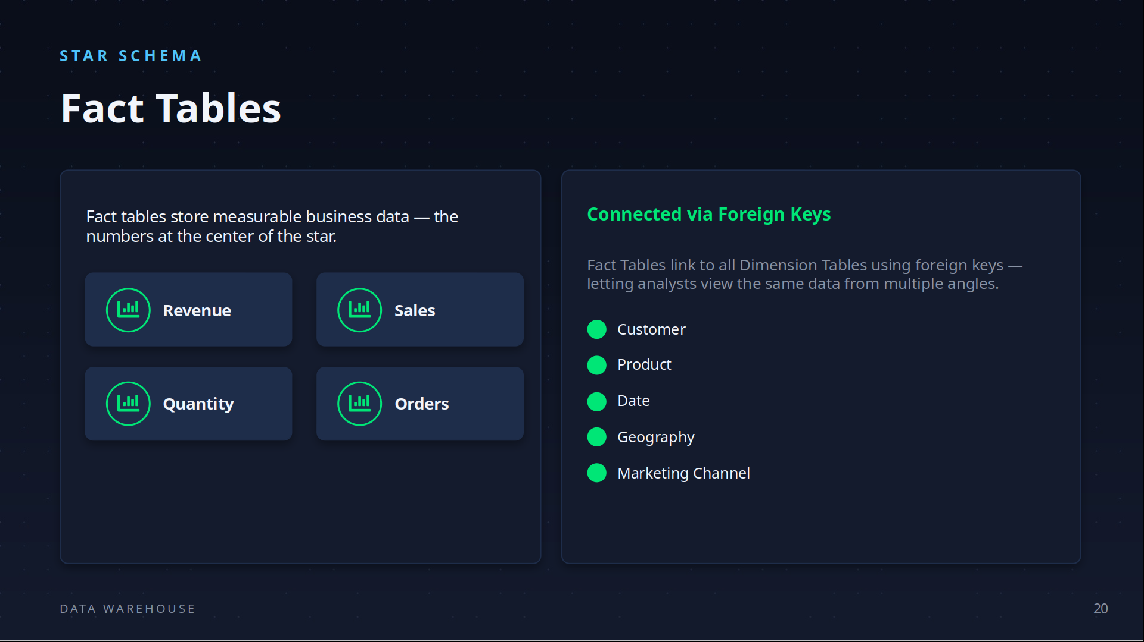

Slide 34
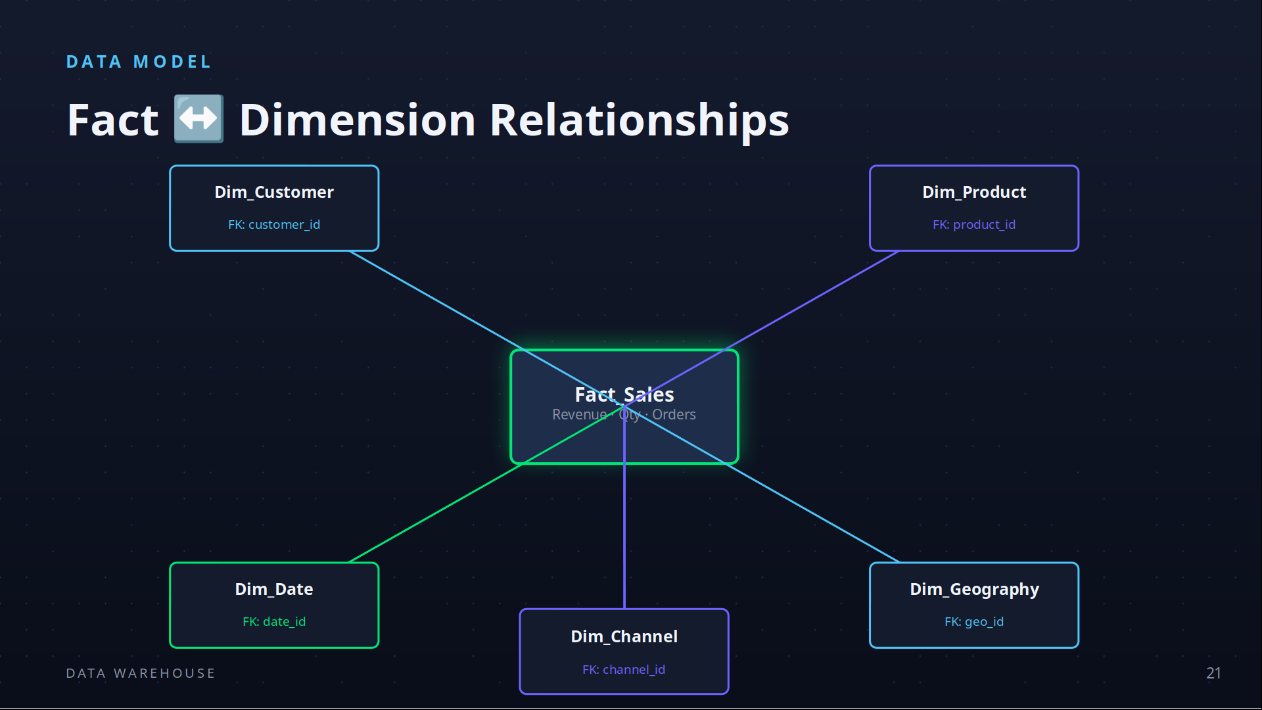

Slide 35
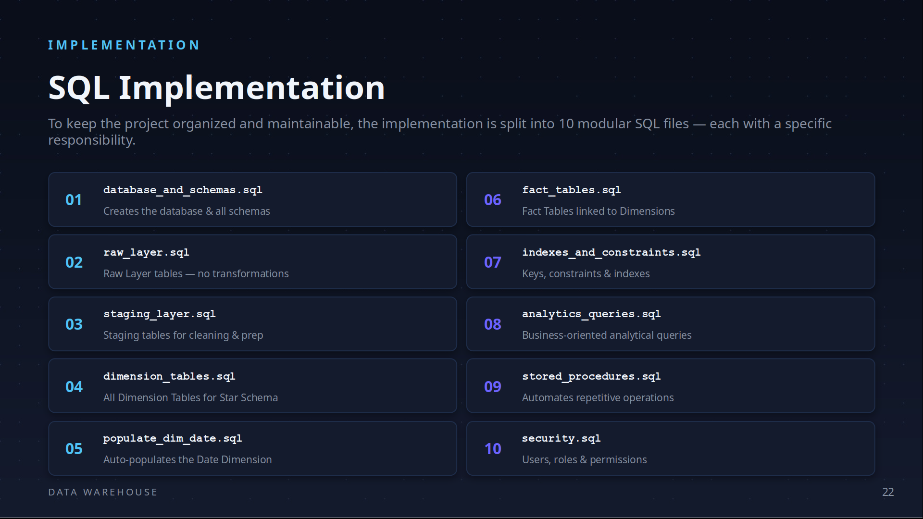

Slide 36
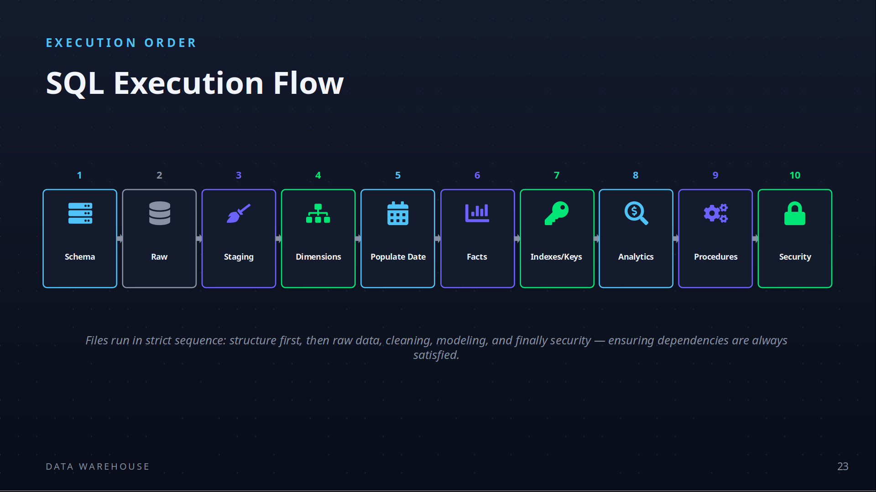

Slide 37
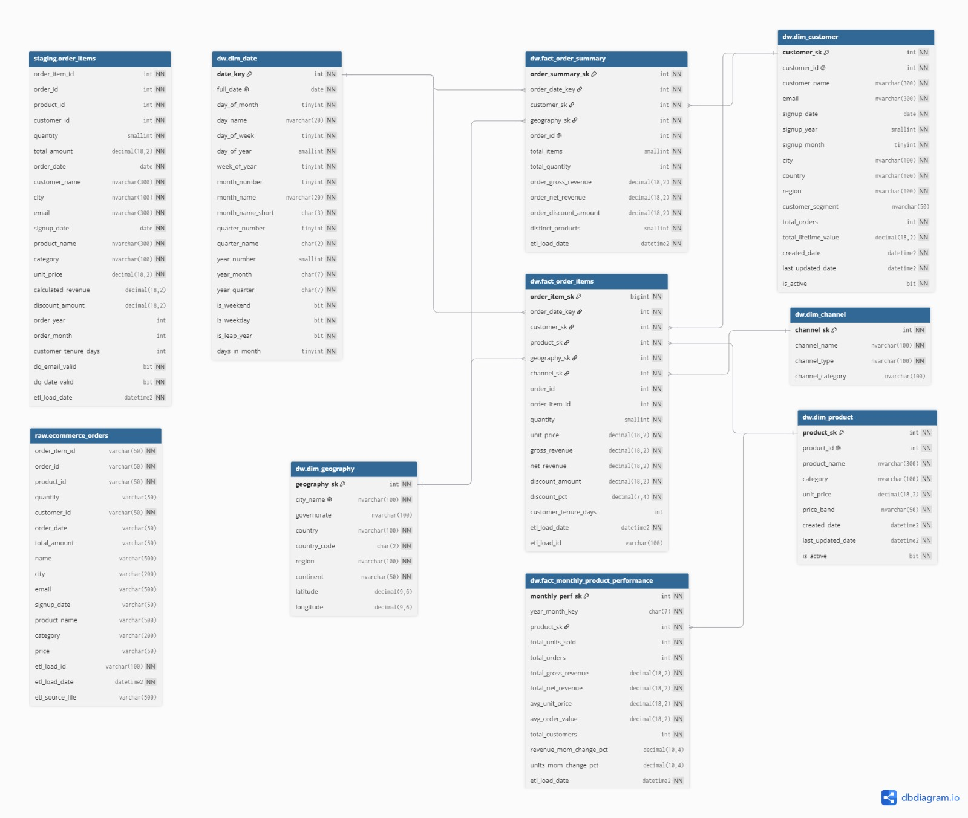

Slide 38
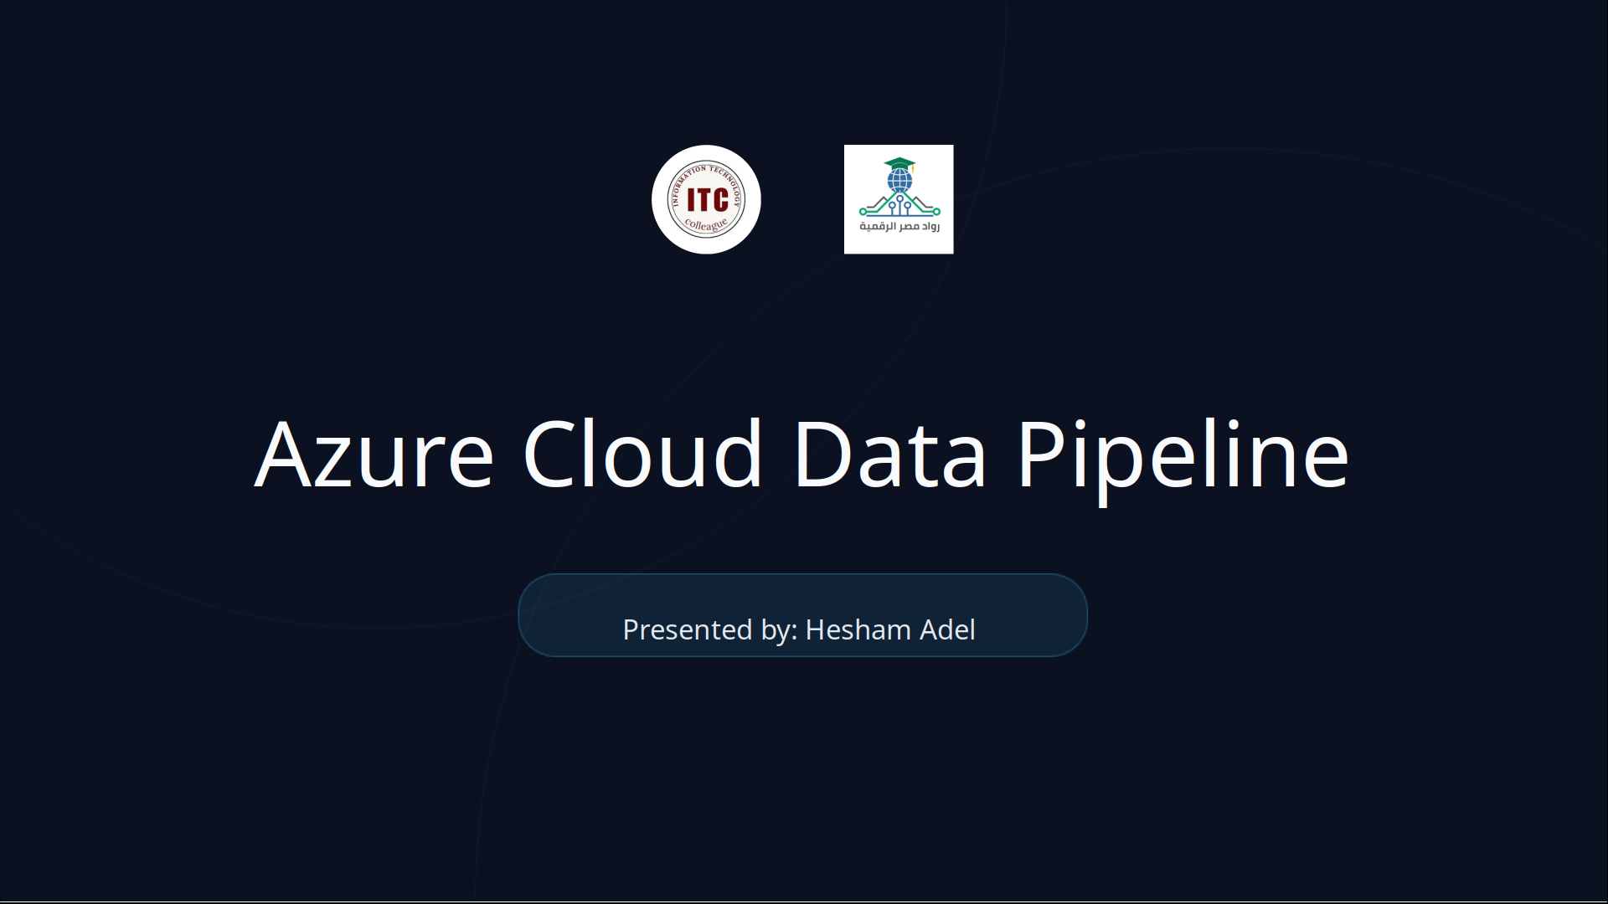

Slide 39
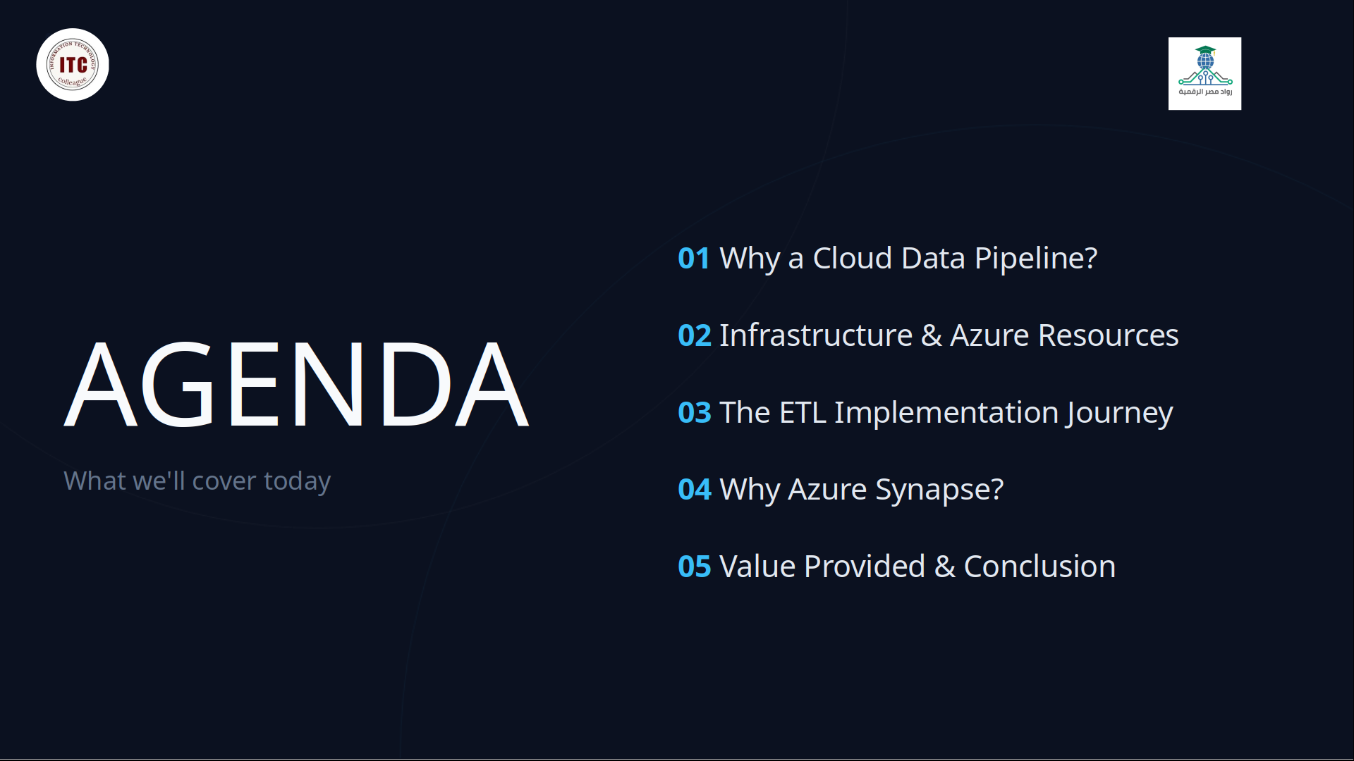

Slide 40
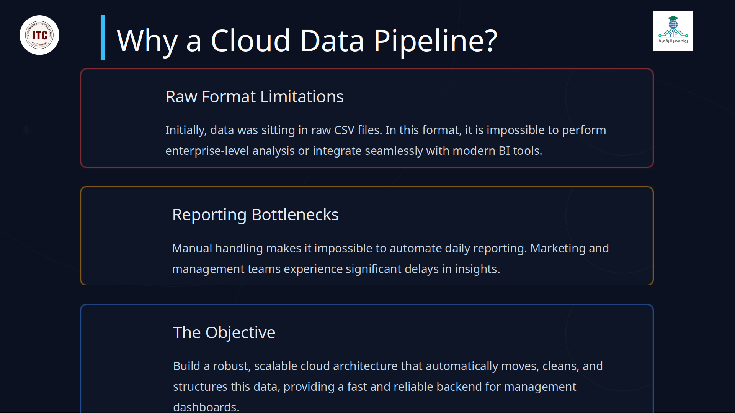

Slide 41
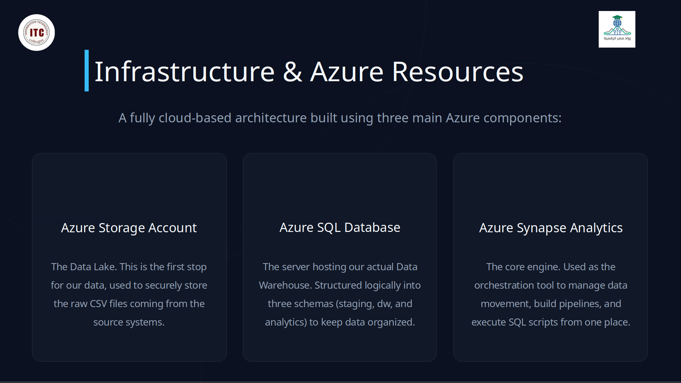

Slide 42
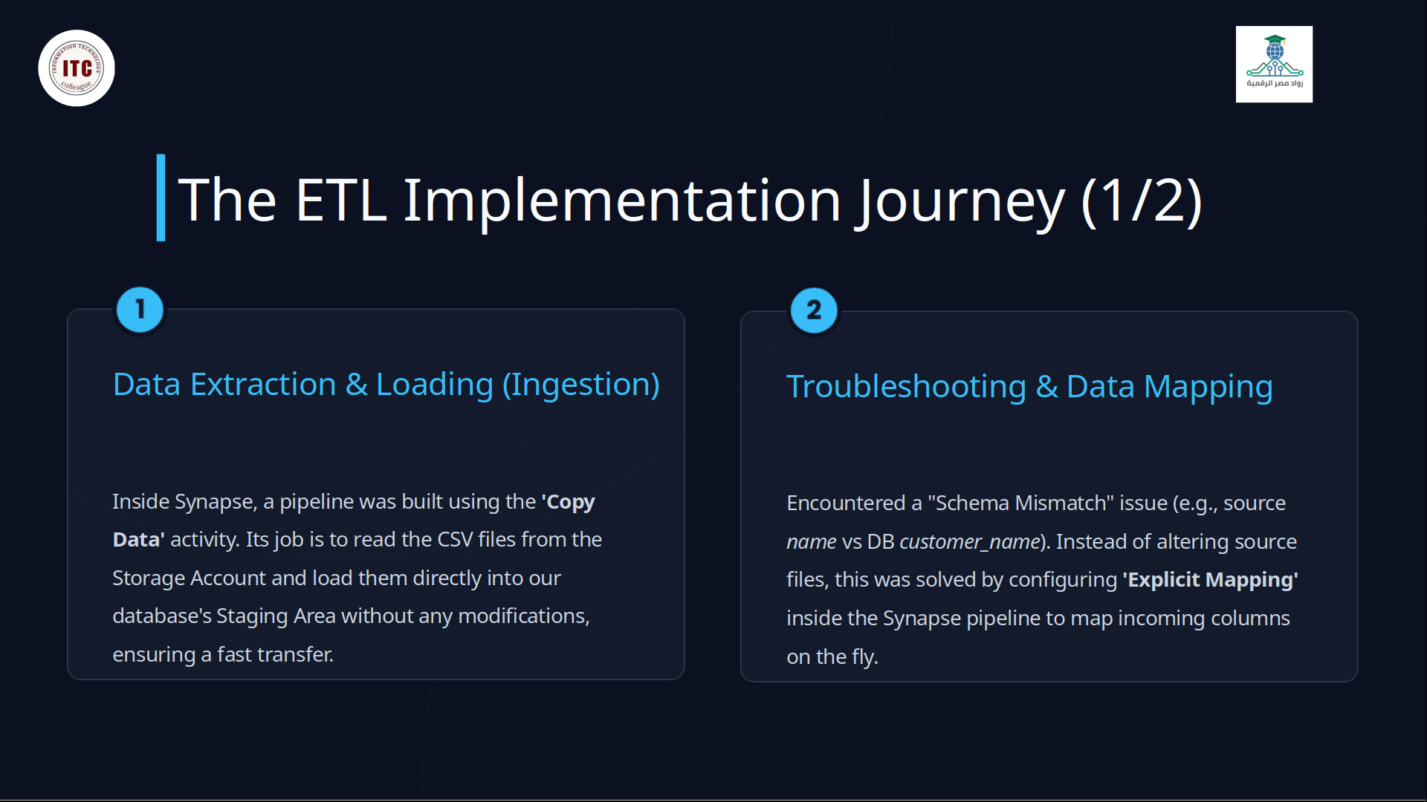

Slide 43
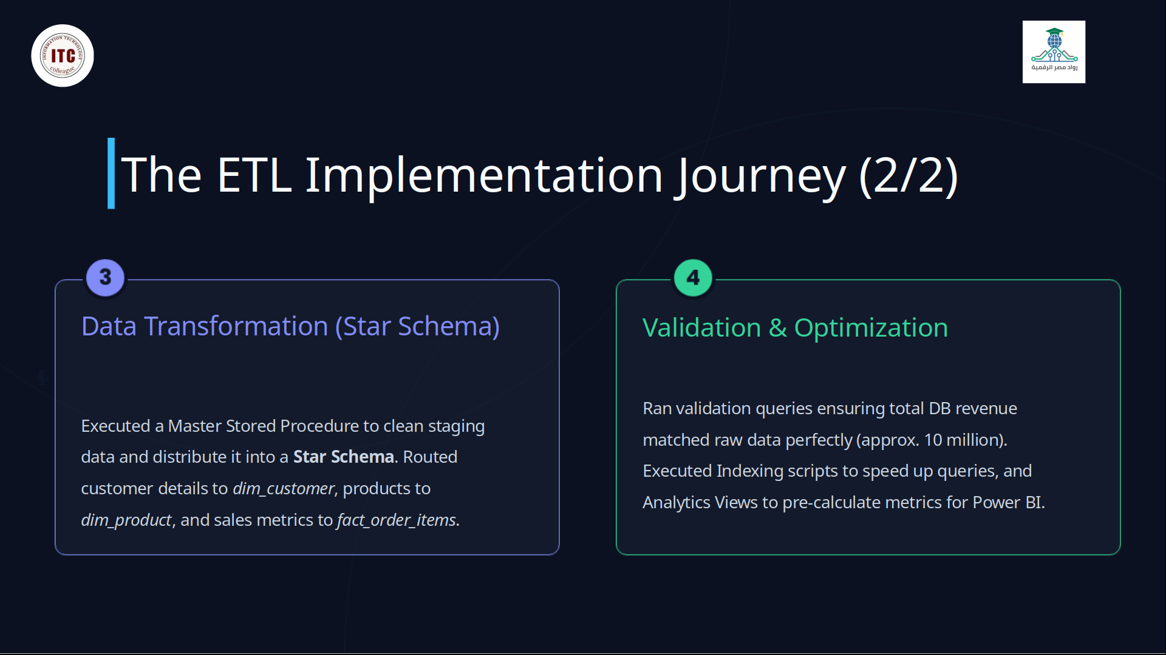

Slide 44
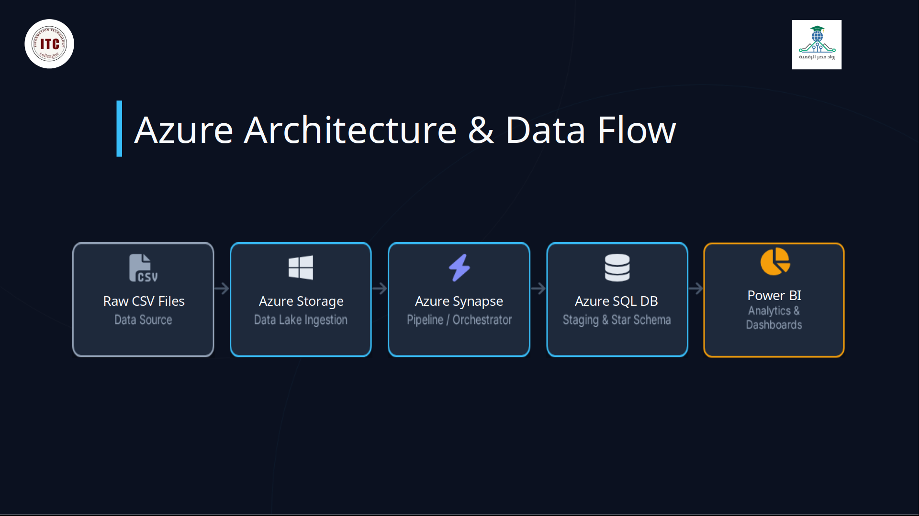

Slide 45
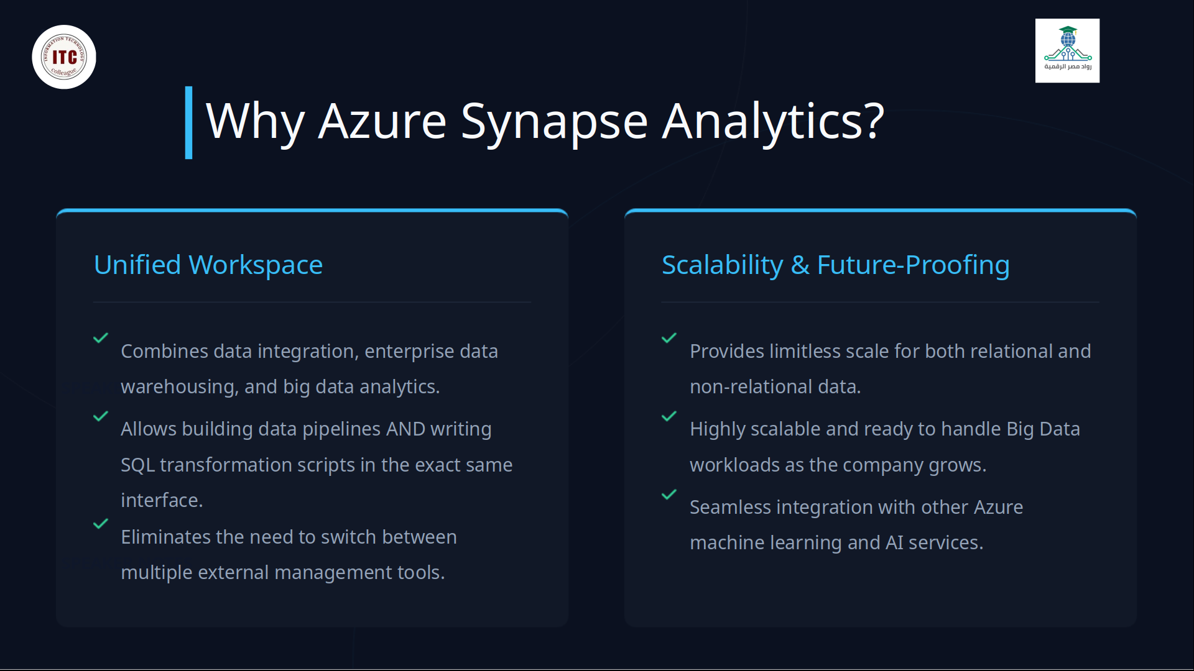

Slide 46
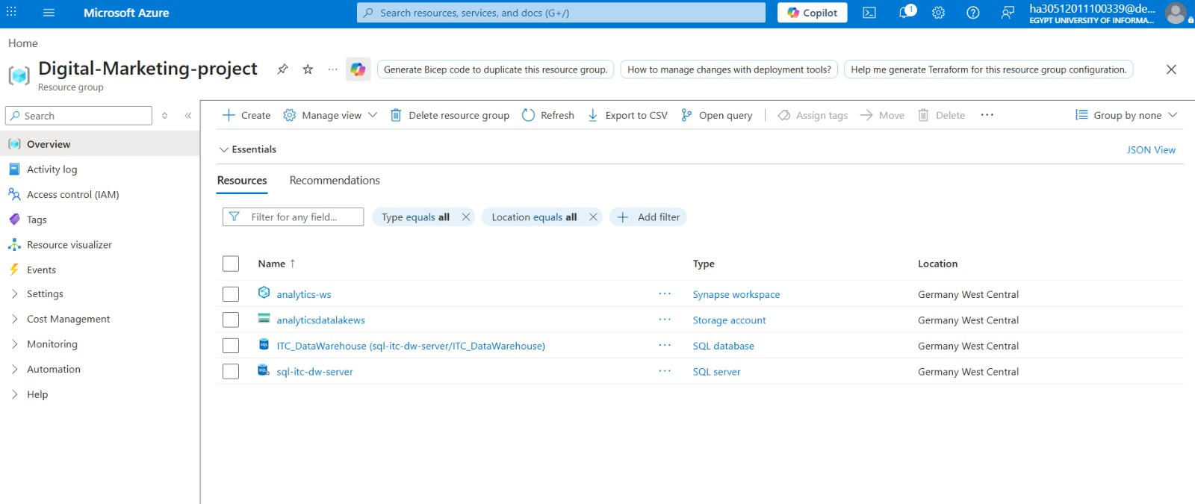

Slide 47
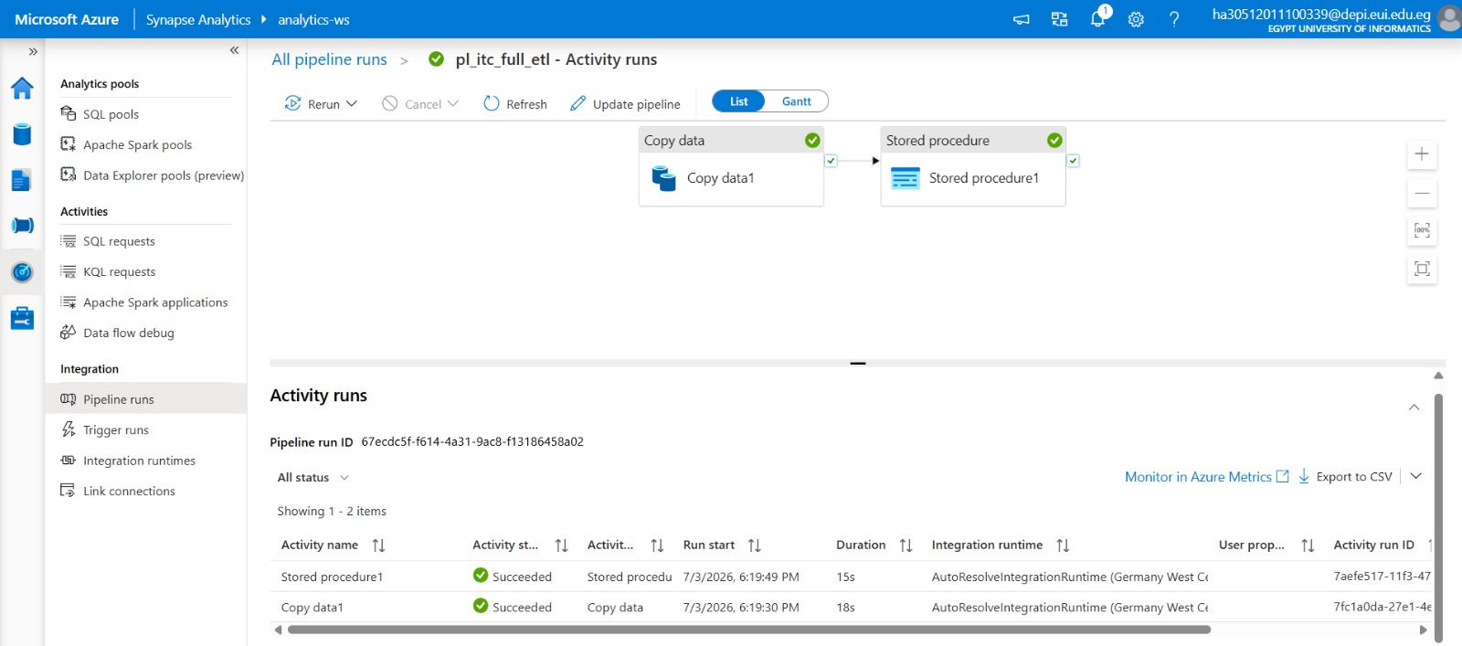

Slide 48
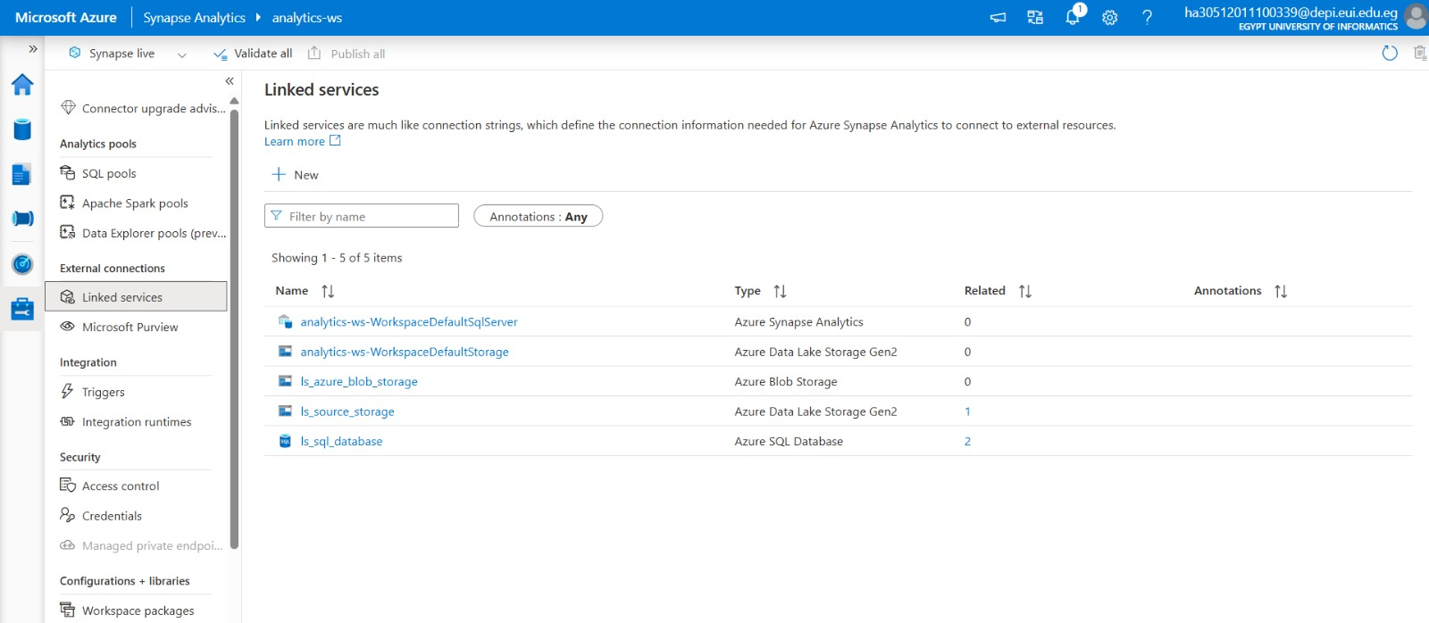

Slide 49
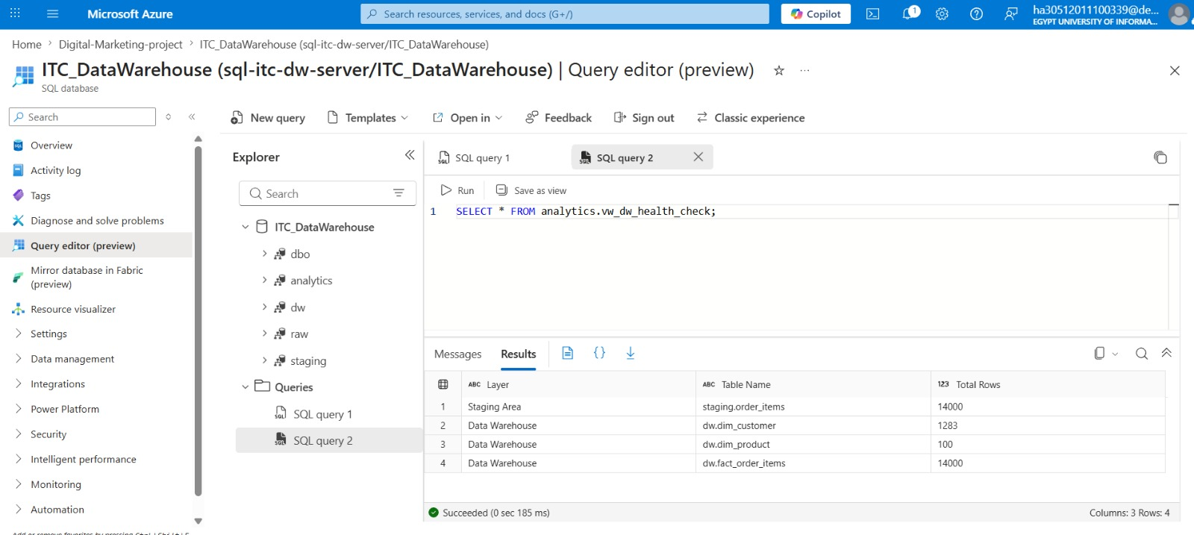

Slide 50
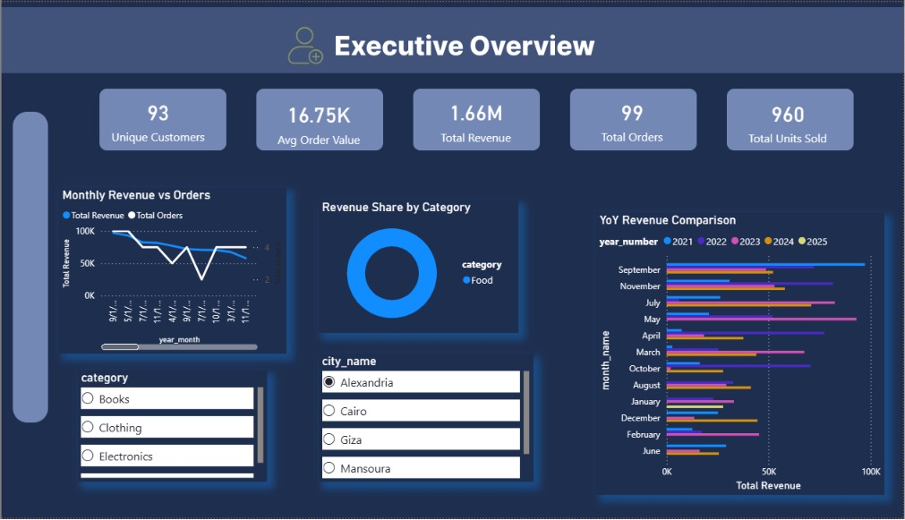
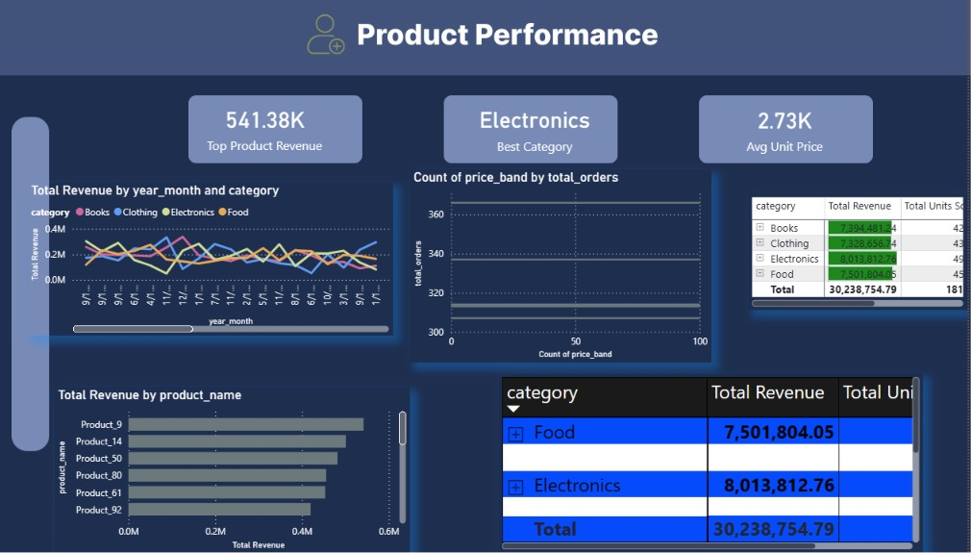
Demo &
Screenshots

Slide 51
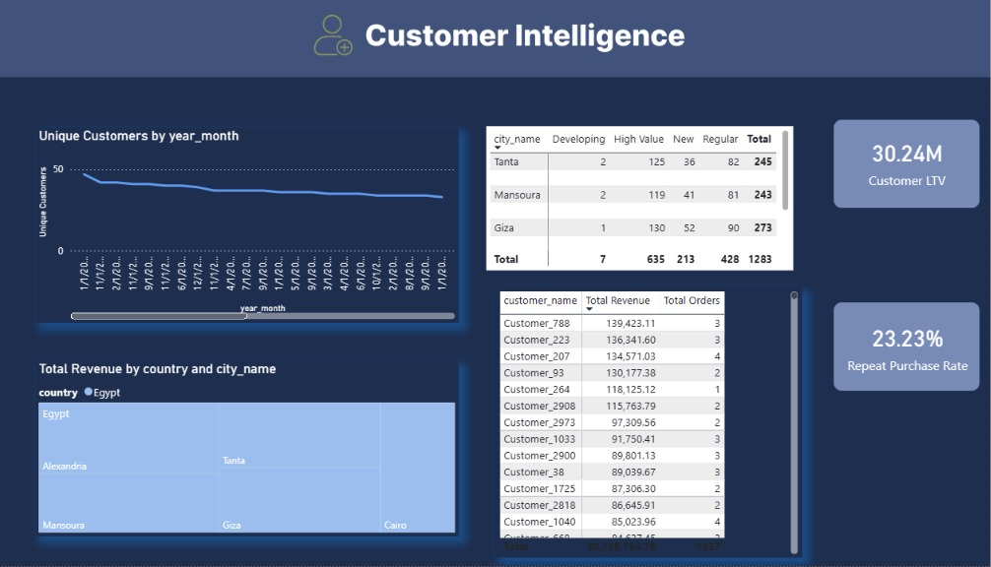
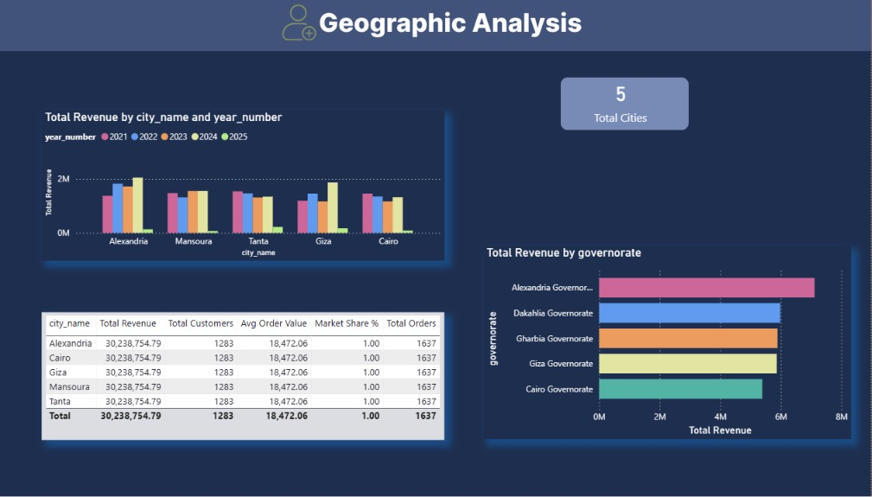
Demo &
Screenshots

Slide 52
Conclusion
Summary
Thank
This project successfully built an end-to-end digital marketing data pipeline that collects, processes, and stores data from multiple sources in a centralized warehouse for analytics.
You!
Learnings
Through this project, we gained practical experience in data engineering concepts such as ETL pipelines, data modeling, cloud storage, and marketing analytics.
هشام عادل— Team Leader
ITC Graduation Project
Future Work
In the future, the system can be enhanced with real-time data streaming, machine learning models, and more advanced analytics dashboards.

